Slide 1
Aim: How does temperature and pressure affect density?
What is density?
The concentration of matter in an object.

Slide 2
How does temperature affect density?
As temperature increases on an object, the molecules move apart.
The mass will always remain the same, except the volume will increase.
Example:

Slide 3
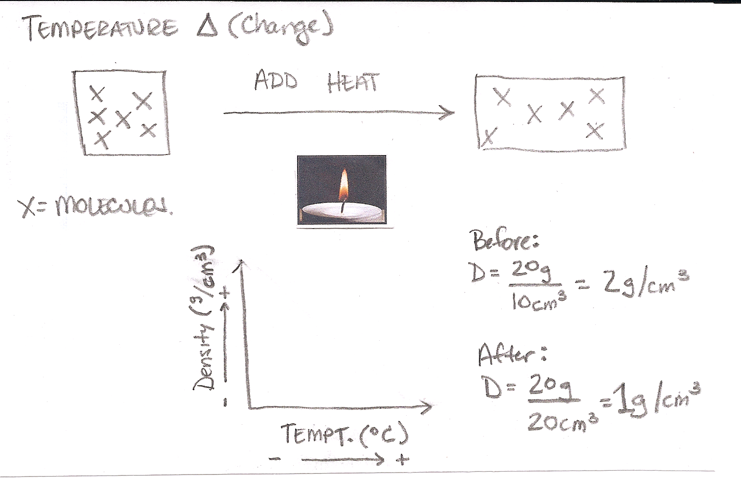

Slide 4
Demonstration:
What happens to the distance between molecules, mass, volume, and density when the object is heated?

Slide 5
How does pressure affect density?
As pressure increases on an object, the molecules move closer together.
The mass will always remain the same, except the volume will decrease.
Example:

Slide 6
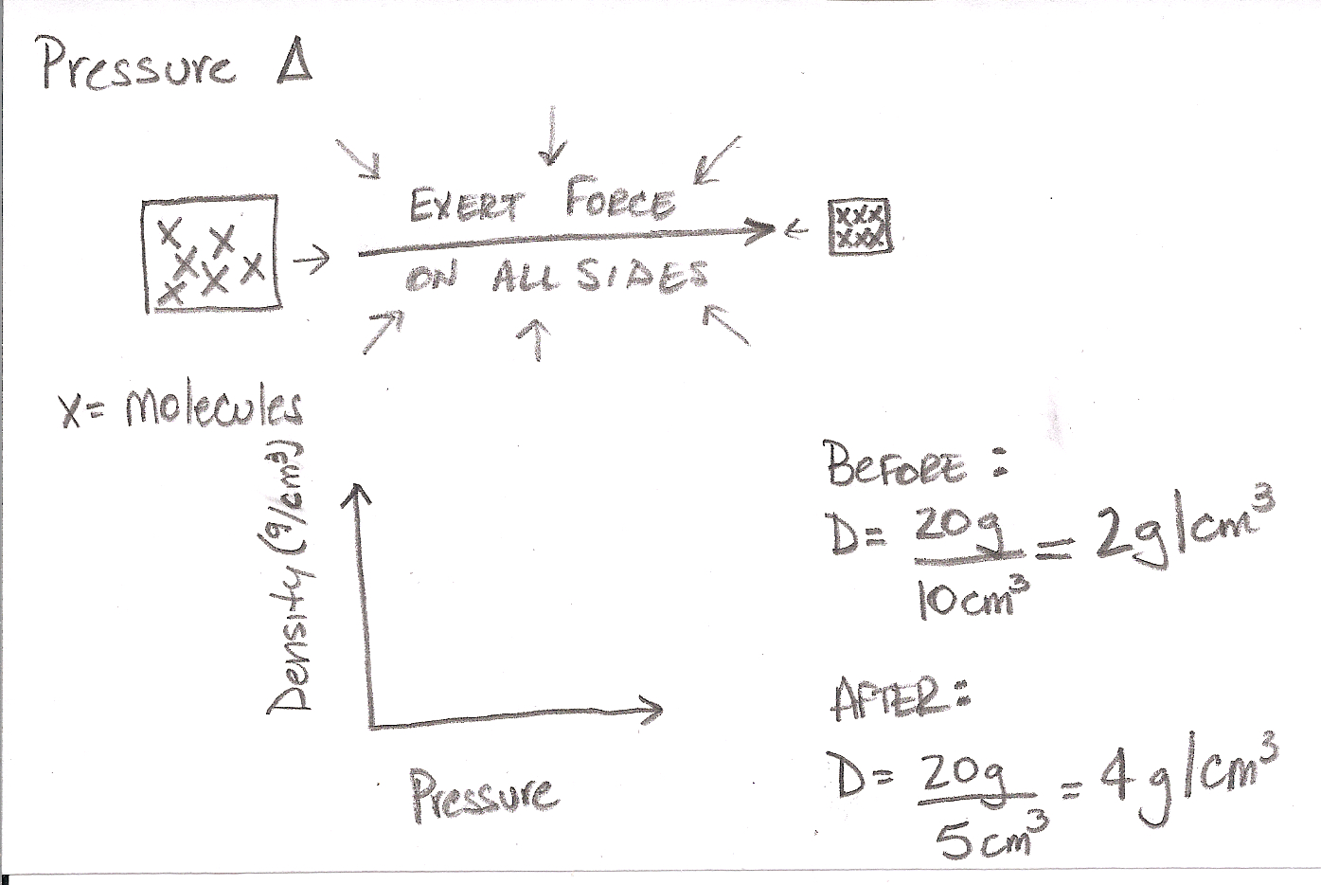

Slide 7
Summary
What happens to the volume of a substance when it is heated?
When a substance is heated, why does its density decrease?
What happens to the volume of a substance when pressure is exerted?

Slide 8
When a substance is pressurized, why does its density increase?

