Slide 1
Aim: What is density?
Density:
The concentration of matter in an object.
Density is very IMPORTANT in the field of Earth Science. Why?
Example: global wind patterns, ocean currents, and molten rock movement in the asthenosphere.

Slide 2
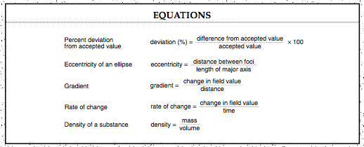
Page 1 of the ESRT:
All objects of the same material that are under the same temperature and pressure have the same density.

Slide 3
Same Density
Fe
Fe
Example:
The original sample of Iron (Fe) is cut into four smaller pieces. When compared to the original density of the original material, the density of each piece of Fe will be?

Slide 4
Which phase of matter is the densest?
Most solids because the molecules are closest together.
Solids → Liquids → Gases
Decreasing Density
Except for WATER. Water is densest in the liquid phase at 3.98° or 4°C. Why???

Slide 5
Water
Liquid at 3.98° or 4°C: 1.0 g/mL
Solid (Ice): approximately 0.9 g/mL
When water is cooled below its freezing point, it will turn to ice and the volume of the ice will expand.
Gas (Vapor): less than 0.9 g/mL

Slide 6
Determining Relative Densities
Floatation of objects in liquid and in gases is one method of determining their relative, or comparative densities.
D = 0.7 g/mL
Q: When a solid piece of granite having a density of 2.7 g/cm3 is dropped into the cylinder of liquids. Which colored layers will it pass through?
D = 1.4 g/mL
D = 2.7 g/mL
D = 3.0 g/mL

Slide 7
What will happen to the blocks when placed in water?
Block B = 0.5g/cm³
Block C = 1g/cm³
B
C
Water
A
D
Block A = 2g/cm³
Block D = 0.3g/cm³

Slide 8
Block A: Sink to bottom
Block B: Float on top, half the block is above the water
Block C: Suspended in water
Block D: Float on top, most of block is above the water
Q: Which block can represent an ice cube? Why?
D
B
C
A

Slide 9
Summary
What is the definition of density?
What is the equation for density? Where can you find this equation?
Of the three phases of matter, which is the densest?
Of the three phases of matter for water, which is the densest? Why?

Slide 10
A student wants to know what will happen when she places three objects in water. The first object is a piece of granite (2.7 g/cm³). The second object is a grape (1.0 g/cm³). The third object is a piece of Styrofoam (0.3 g/cm³).

