Slide 1
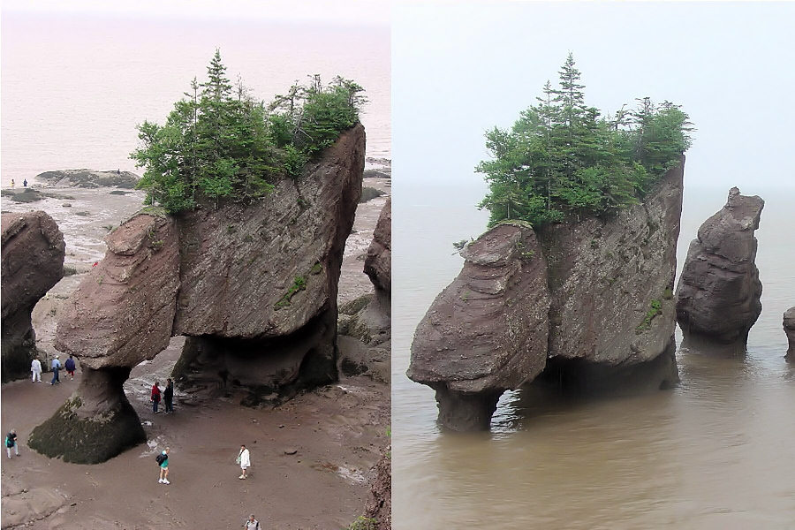
Aim: How can scientists determine change on Earth?

Slide 2
Observations of our environment show that change occurs all the time.
Some changes occur very slowly (seasonal changes) and other changes occur very rapidly (earthquakes).
Change is the occurrence of an event.
Event: change in the properties of an object or a system.

Slide 3
Frames of Reference
There must be some frame of reference when studying change.
Time and change are the frames of reference.
Example:
Over a long period of time, a landscape region can change from a mountainous area to a flat plain.

Slide 4
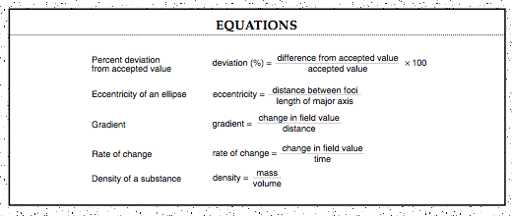
Rate of Change
How fast something changes over time.
Page 1 of the ESRT:

Slide 5
Cyclic Change
Many changes occur in some orderly fashion.
These events repeat in a given amount of time.
What are some examples of cyclic changes?
Water, rock, and sunspot cycles, tides, seasons, motions of objects in space.

Slide 6
Predictions
Type of inference about conditions for the future.
Predictions can be made if the amount, type, and direction of change are determined.
What are some some predictable events?
Eclipses, positions of objects in the sky, hurricane tracking, short-term weather.

Slide 7
Energy and Change
During change, energy flows from one part of the environment to another part of the environment.
Initially, energy is lost and it is gained someplace else.

Slide 8
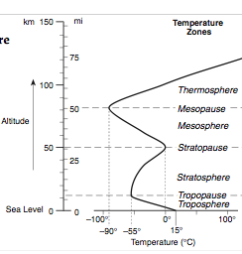
What is an interface?
A boundary where energy exchange takes place, or between regions.
Example: pg. 14 ESRT
Tropopause
Stratopause
Mesopause

Slide 9
Changes
On Earth, most changes occur on a small scale.
Earth remains in DYNAMIC EQUILIBRIUM.
What does it mean to be in dynamic equilibrium?
When there is a balance between changes.

Slide 10
Earth is never in static equilibrium because there are constant changes.
Large scale changes can upset the dynamic equilibrium of a system.
What are some examples of large scale changes?

Slide 11
Summary
Give an example of change that occurs relatively fast.
Give an example of change that occurs relatively slowly.
What is the definition of rate of change?
What is the equation of rate of change? Where can you find the equation?

Slide 12
What rate did the temperature rise between 10:00 a.m. (16°C) to 12:00 p.m. (20°C)?
What is an interface?

