Slide 1
Aim: How can instruments give us numerical values?
Tools to help us extend our senses.
What are some examples of instruments scientists use to extend their senses?
What are measurements?

Slide 2
Using instruments to determine physical properties of substances.
Measurements are compared to known standards.
Provides numerical values
2 types of measurements:
Fundamental
Derived

Slide 3
Fundamental Units:
Contains only one unit, or variable.
Length: distance between two points.
Units used are meters (m), centimeters (cm), inches (in), feet (ft), etc.
What kind of instruments are needed to determine the length between two objects?

Slide 4
Mass: amount of matter in an object.
Units used are grams (g), kilograms (kg), pounds (lbs), etc.
Instrument: Triple-Beam Balance & Electronic Scale.
How can you determine the mass of a solid?
How can you determine the mass of a liquid?

Slide 5
Temperature: is a measure of the average heat of particles in a substance.
Units used are Fahrenheit (°F), Celcius (°C), and Kelvin (°K).
Instrument: Thermometer
Time: duration of an event.
Units used are seconds (s), minutes (min), hours (hrs), etc.
Tools: clock and stopwatch

Slide 6
Derived Units: combination of 2 or more fundamental units.
Volume:
the amount of space an object occupies.
Volume can be measured directly and indirectly (2-ways).
Directly: cubic solid (L x W x H), cm³
Indirectly: water displacement in a graduated cylinder. Measured in milliliters (mL).

Slide 7
How can you determine the volume of a cube?
What is the volume of an object if the length is 4 cm, the width is 8 cm, and the height is 3 cm?
How can you determine the volume of an irregular-shaped object or a sphere?

Slide 8
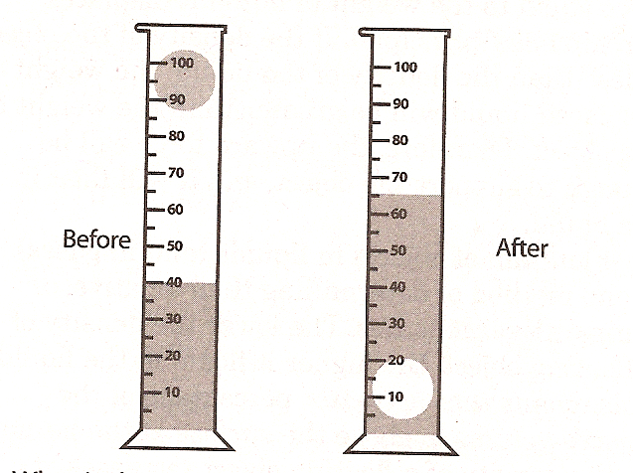
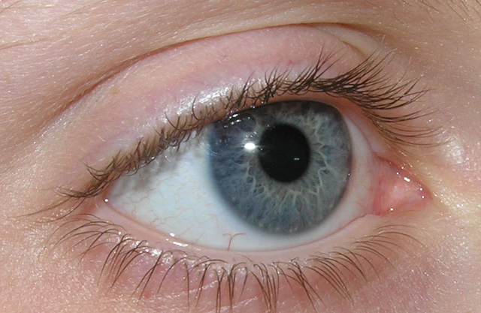
A sphere was dropped into a graduated cylinder. What is the volume of the sphere?
65mL – 40 mL = 25 mL
40mL
65mL

Slide 9
Density: the concentration of matter in an object.
m
D = mass
x
Volume
D
V
V = m
m = D x V
D
A student measures an object to have a total volume of 35cm³ and a mass of 70 g. What is the object’s density?

Slide 10
Summary
What is the definition of an instrument?
What are some examples of instruments to determine:
1) Length:
2) Mass:
3) Temperature:
4) Time:

Slide 11
What are some examples of derived units of measurement?
How can you determine the volume of a geometric object?
How can you determine the volume of an irregular-shaped object?
What is the volume of an object that has a mass of 15 grams and has a density of 5 grams per centimeter cubed?

Slide 12
What is the density of an object that has a mass of 50 grams and a length of 2cm, a width of 2cm, and a height of 1cm?

