Slide 1
Aim: What is percent error (percent deviation)?
How far off are your results from the TRUE, ACCEPTED, or ABSOLUTE value.
Values are expressed as a percentage (%).

Slide 2
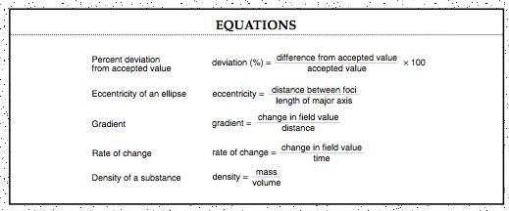
Page 1: Earth Science Reference Table (ESRT):

Slide 3
Example:
A student’s measurement of the mass of a rock is 30 grams. If the accepted value for the mass of the rock is 33 grams, what is the percent deviation of the student’s measurement?

Slide 4
Summary
The accepted mass of a liquid is 600 grams, but a student measures the mass as 612 grams. What is the percent deviation of the student’s measurement?
A student determines the latitude of a city to be 42°N. When the student uses a globe, the actual latitude is 50°N. What is the student’s percent deviation?

Slide 5
A student measures the velocity a stream as 5.5 m/sec. The actual velocity of the water is 6.0 m/sec. What is the student’s percent deviation?

