Slide 1
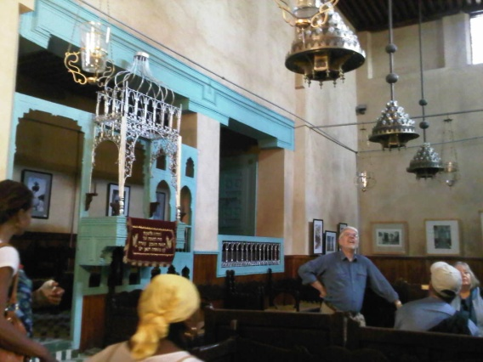
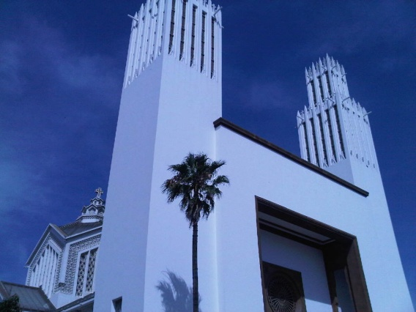
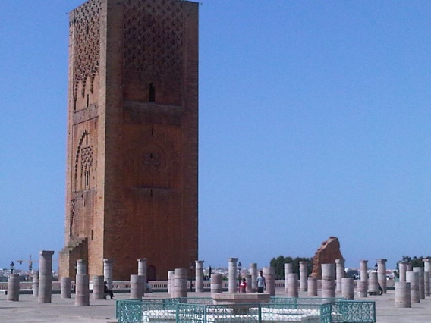
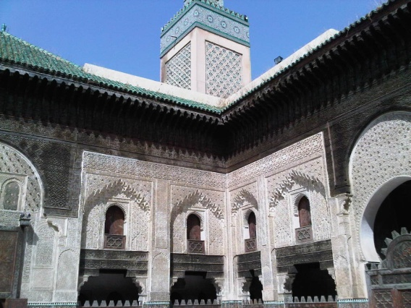
Religious Diversity in the Maghreb – Morocco & tunisia
Fulbright-Hays Seminar Abroad – Summer 2011
Prof. Michael J. Miller, Queens College, CUNY

Slide 2
Fulbright-hays
U.S. Dept. of Education, International & Foreign Language Education (IFLE)
The Seminars Abroad Program “…provides short-term study and travel seminars abroad for U.S. educators in the social sciences and humanities for the purpose of improving their understanding and knowledge of the people and culture of other countries.”

Slide 3
Summer 2011 Program
Religious Diversity in the Maghreb
“Morocco and Tunisia provide insights into the roles that Judaism, Christianity, and Islam have played in a part of the world that is at the same time African, Mediterranean, Arab, and Berber. This seminar seeks to draw lessons focusing on religious tolerance and cooperation among the faiths in shared environments.”

Slide 4
The Way Forward: A DIGITAL CASE STUDY
Curriculum Project Required
Developing a digital curricular aid to support teaching and learning inter-faith, inter-ethnic, and inter-racial dialogues for classes across the curriculum.
Case study will feature writings, outlines, talking point list, photos and audiovisual artifacts from the seminar.

Slide 5
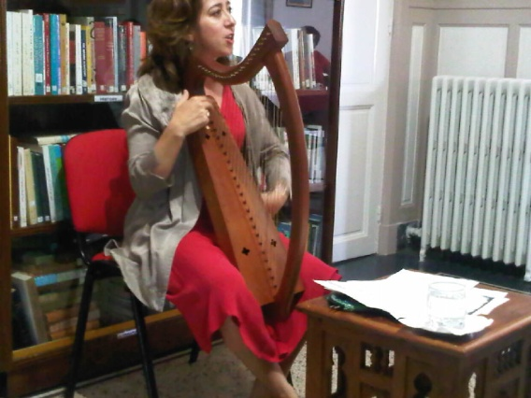
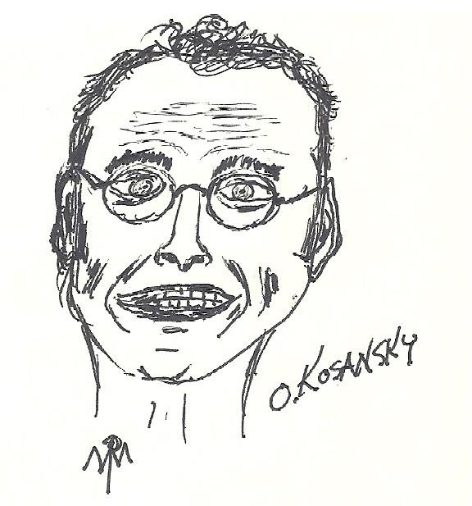
On the ground - Morocco
Rabat
Chellah – Medina – Oudayas (sites)
Arabic & Home Stays & Birthdays
Lectures
Vanessa Paloma (Judeo-Spanish Music)
Mansour (Islam)
Khalfi (Religion & Politics)
Kosansky (Judaism)
Mernissi (Consumerism)

Slide 6
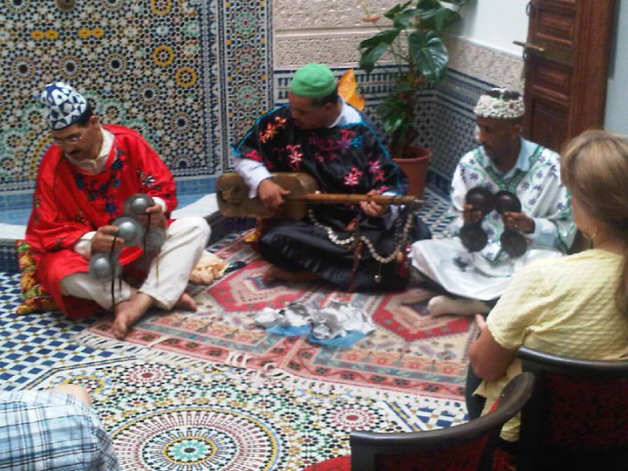
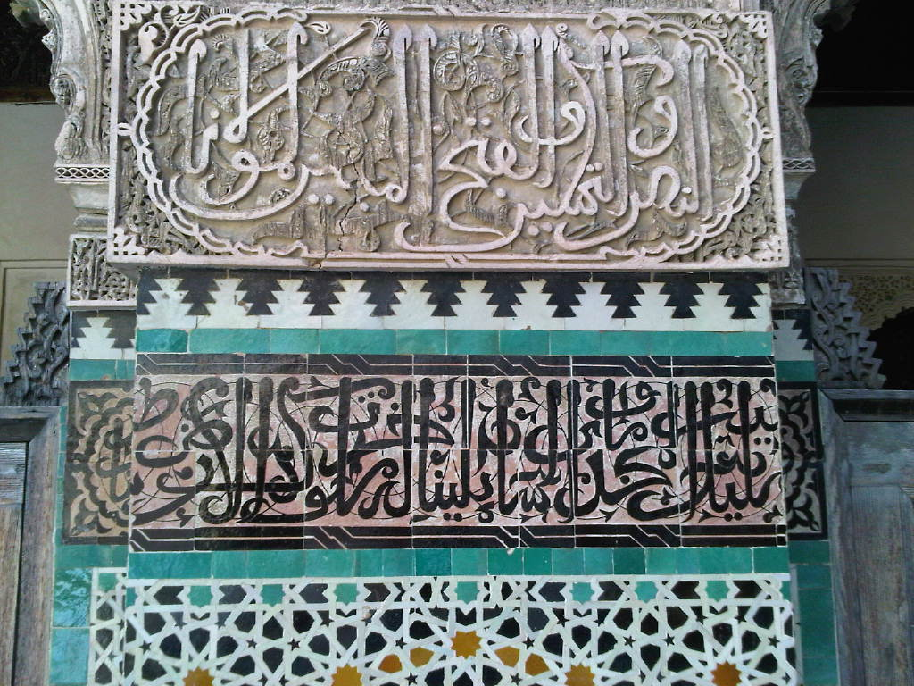
On the ground - Morocco
Fes
Mass, Medina, Handicraft Center, Mellah, Synagogues, Mosques
Musee Dar Batha, Volubilis, Al Akhawayn Unv.
Lectures
- Kobaiti (Sufism)
- Witulsky (Gnawan music)
- Rddad (Sufism and youth)
- Monette (Maghreb as interfaith model)

Slide 7
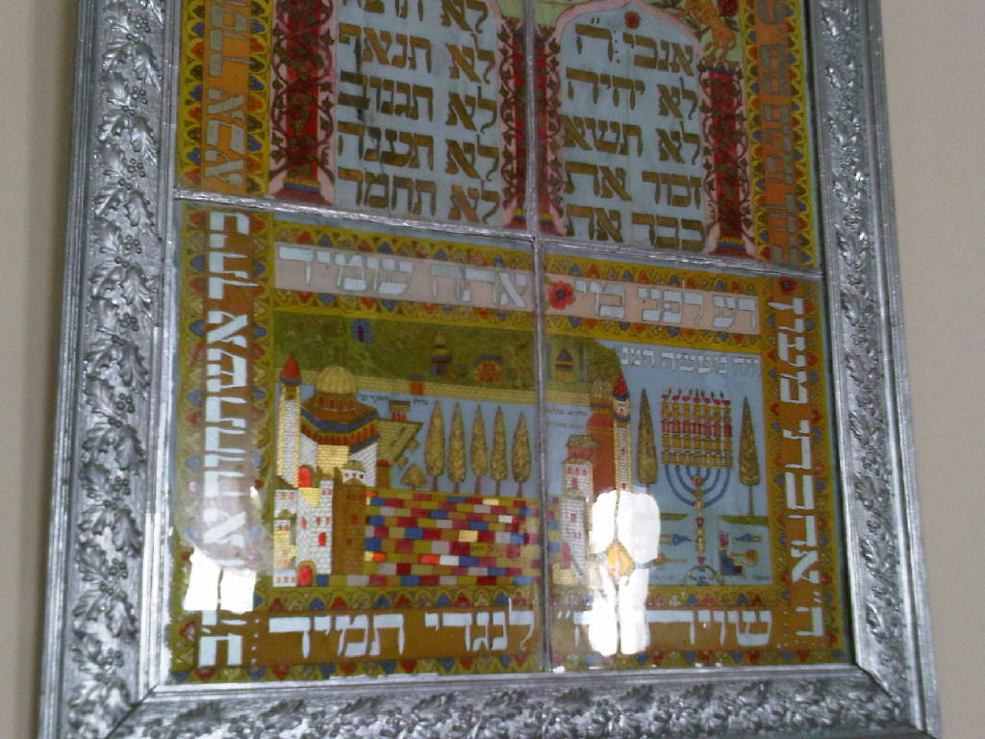
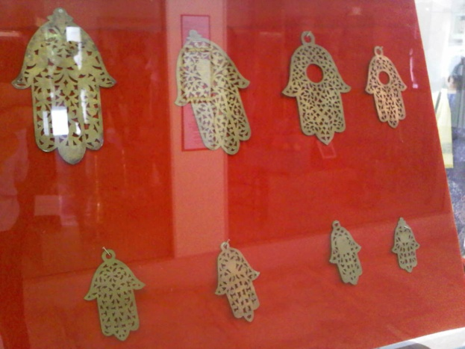
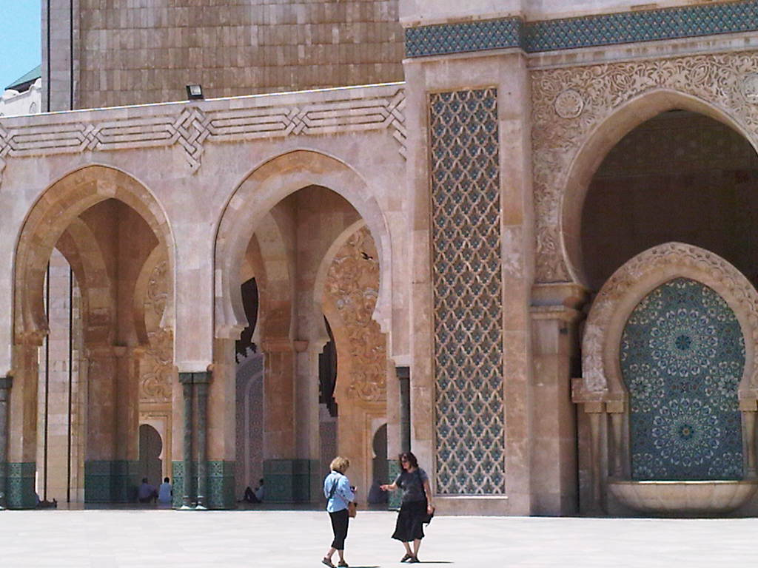
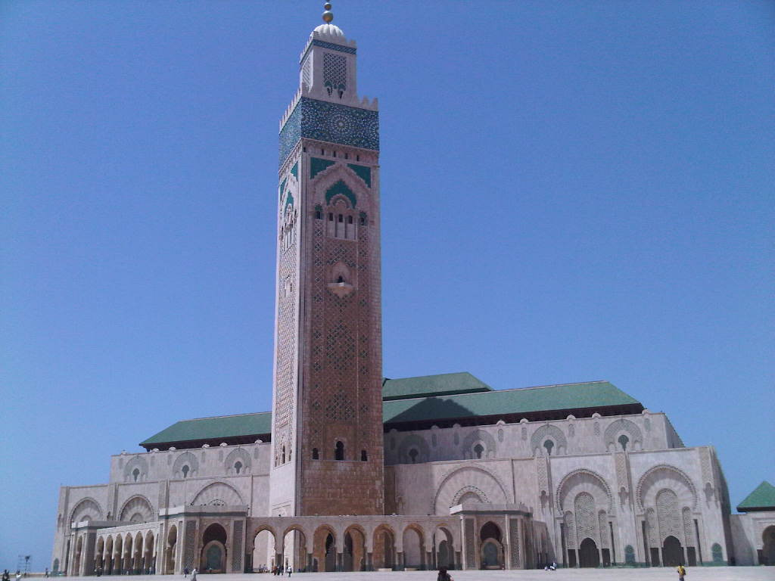
On the ground - morocco
Casablanca
Jewish Museum, Hassan II Mosque

Slide 8
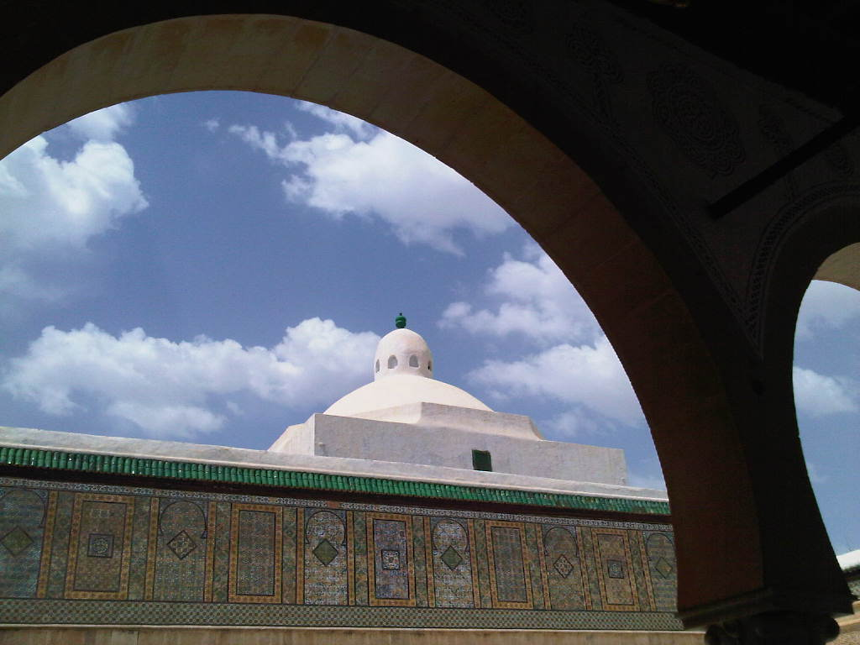
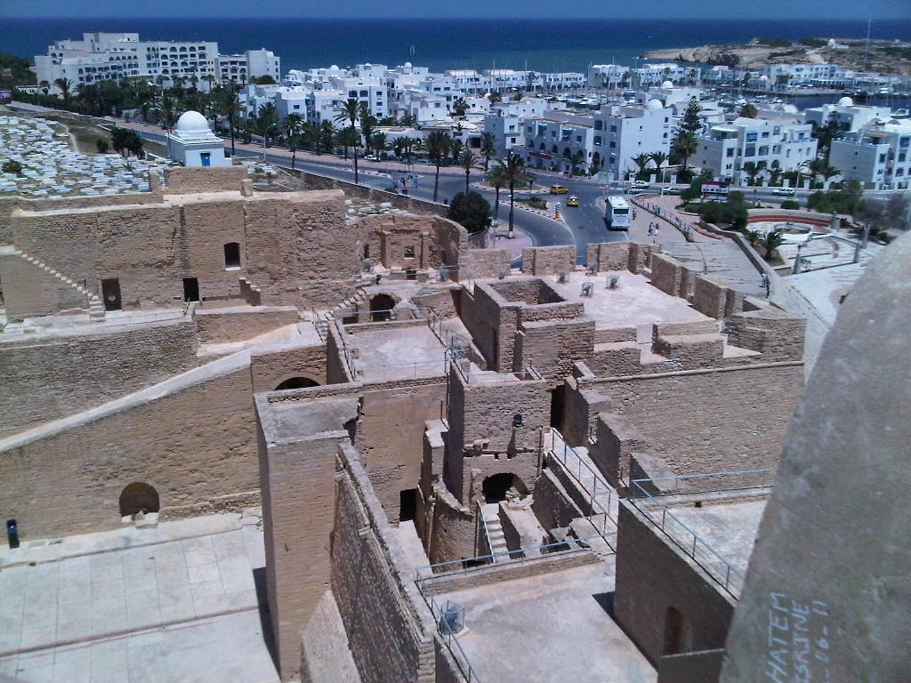
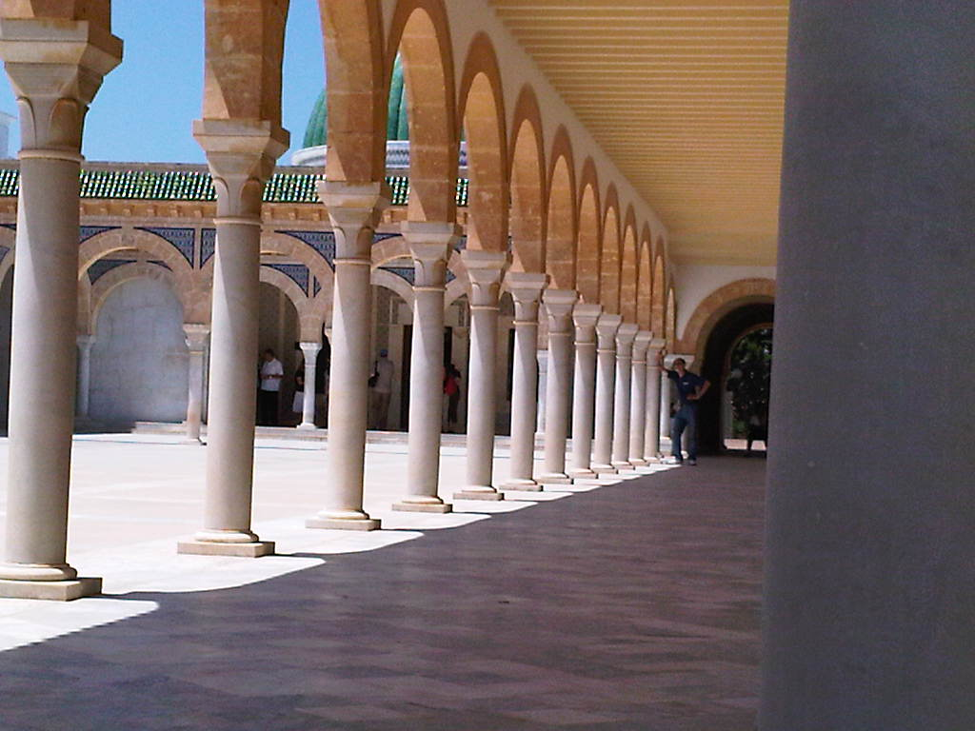
On the ground - tunisia
Kairouan – Sousse – Monastir - Mahdia

Slide 9
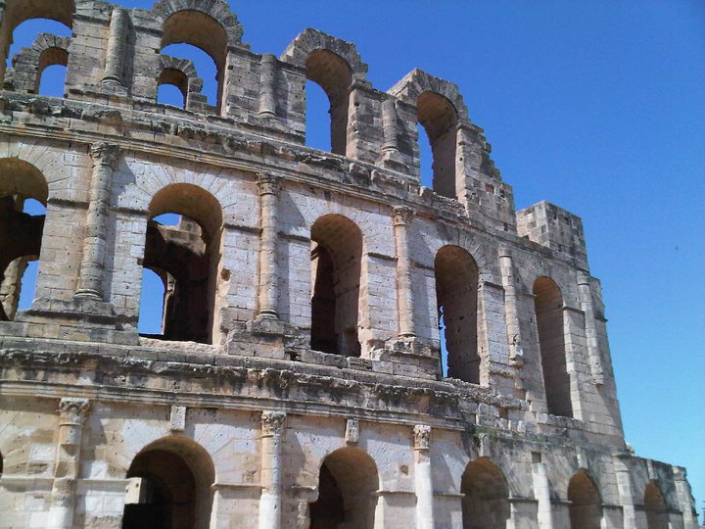
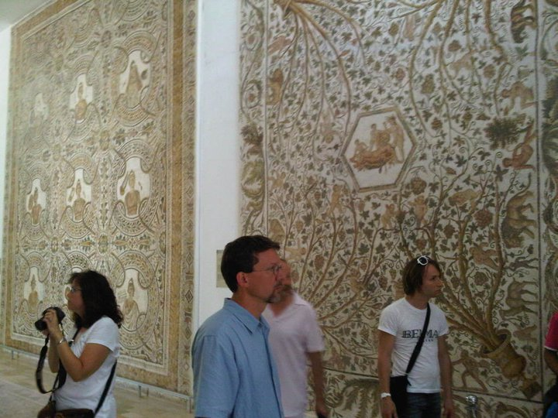
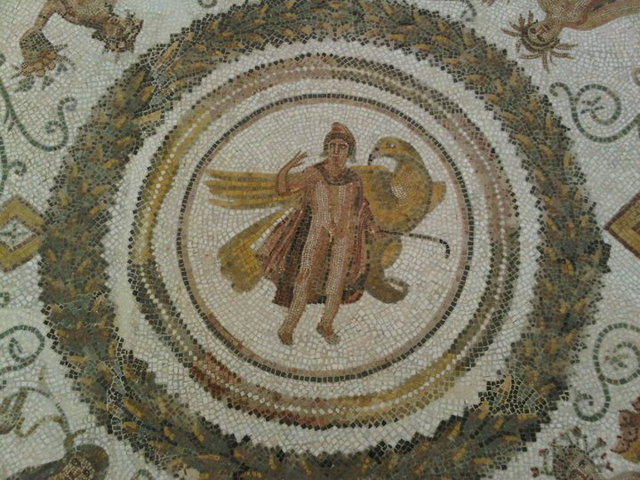
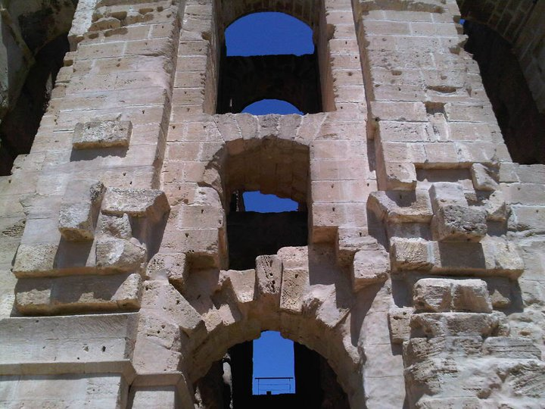
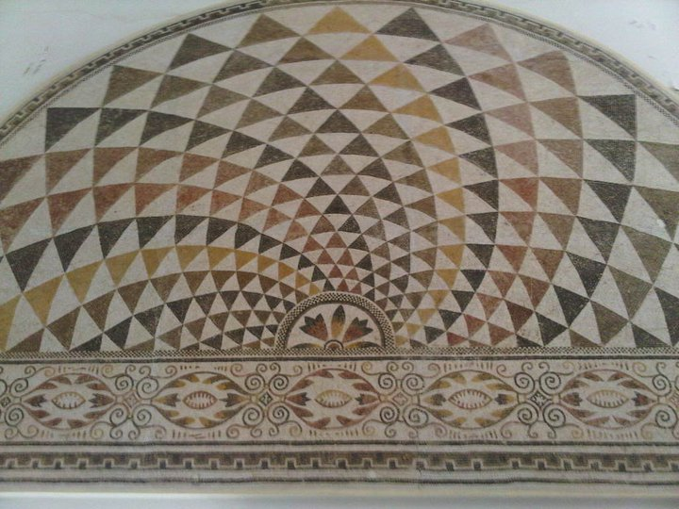
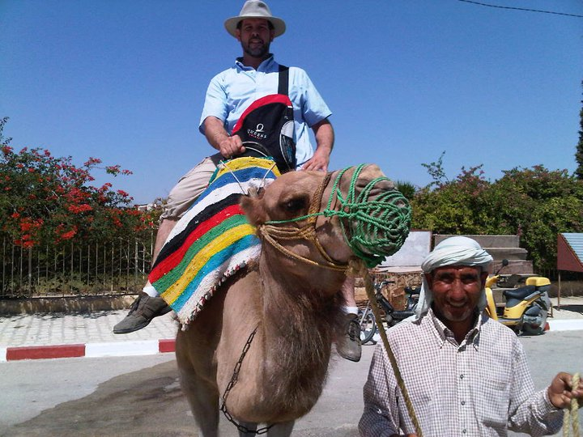
On the ground - Tunisia
El Jem
Roman Amphitheatre & Archeological Museum

Slide 10
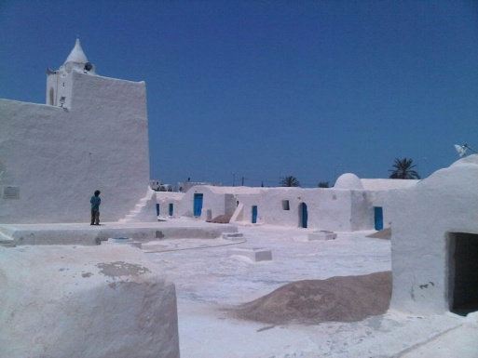
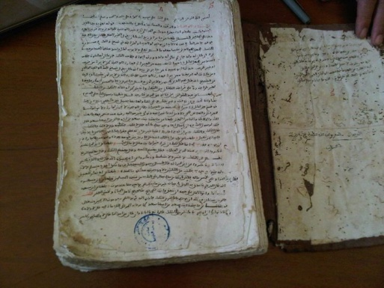
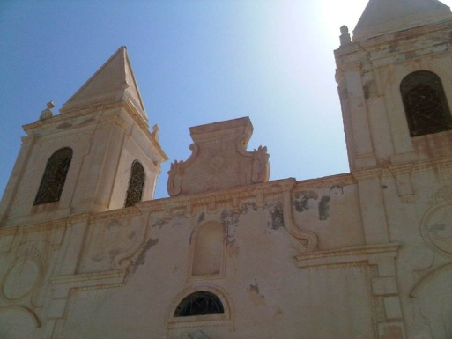
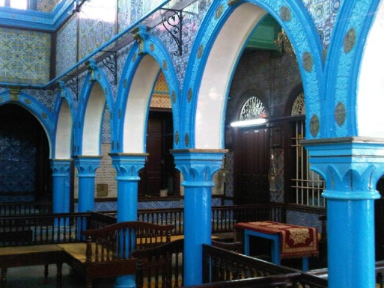
On the ground - tunisia
Kerkennah & Djerba
El Ghariaba Synagogue, Eglise St.-Joseph, Houmt Souk
Lectures
- Love (Fatimids, Kharijites, Ibaldi)

Slide 11
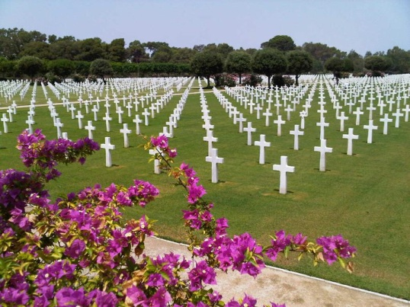
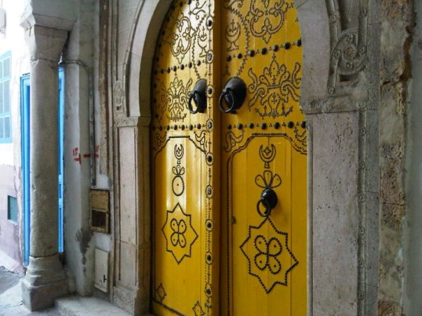
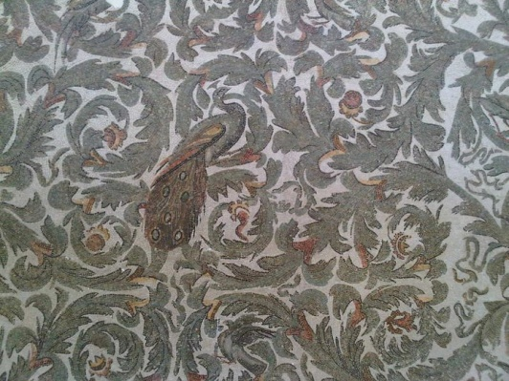
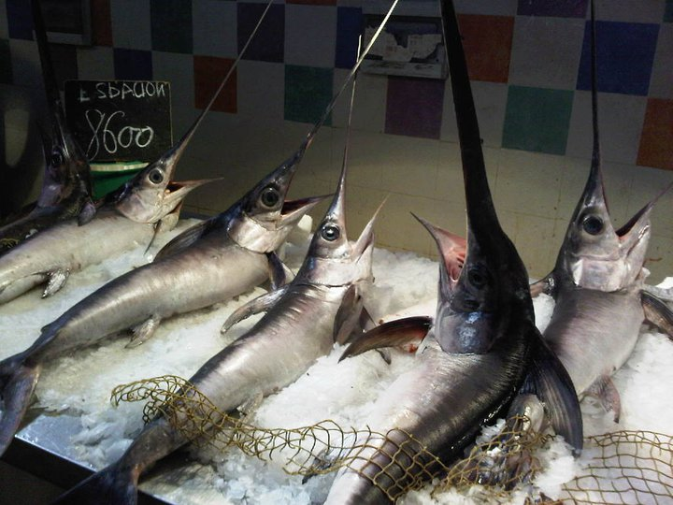
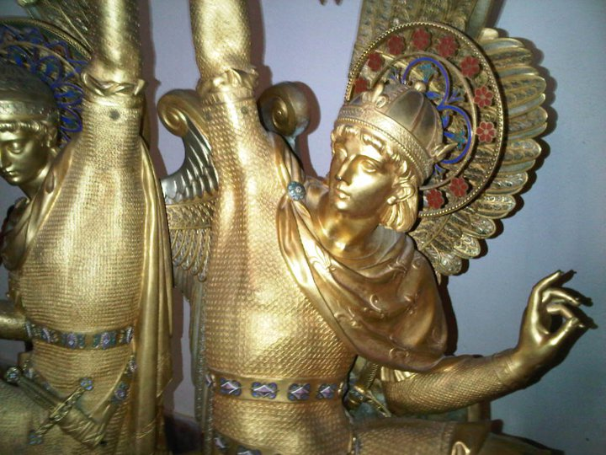
On the ground - tunisia
Tunis
American Cemetary, Sidi Bou Said, Medina, Cathedral St. Louis, Bardo Museum

Slide 12
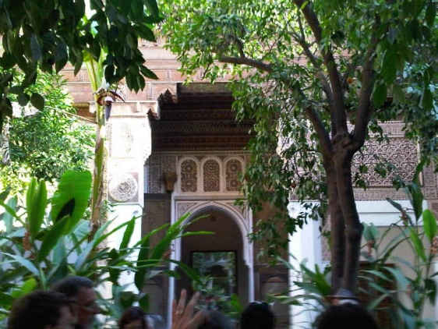
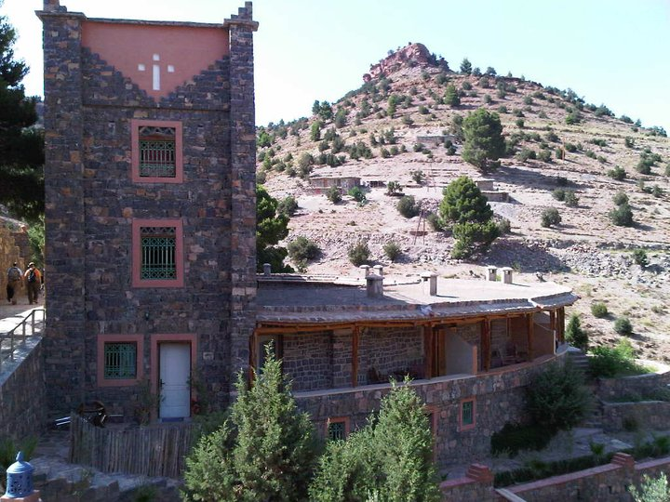
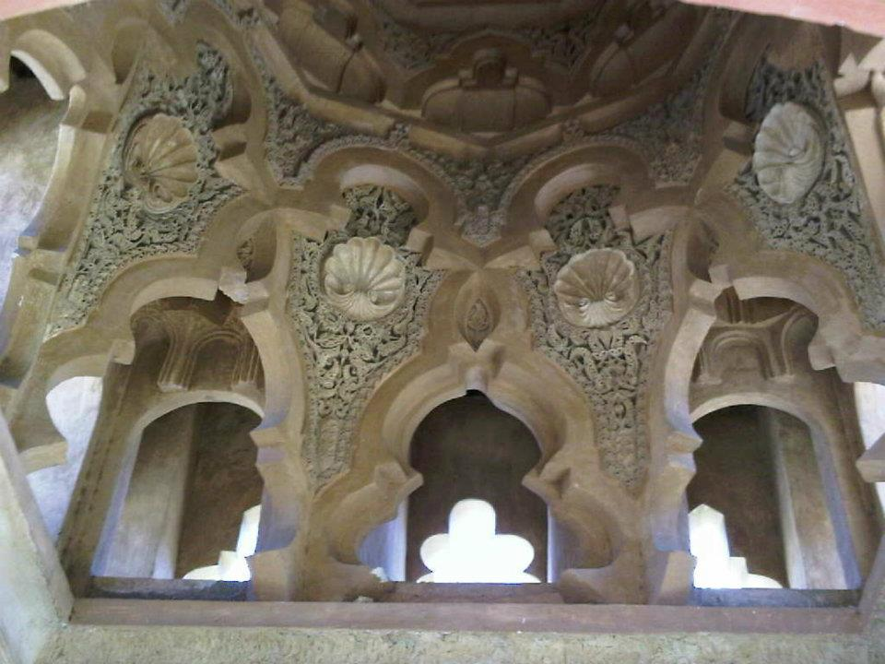
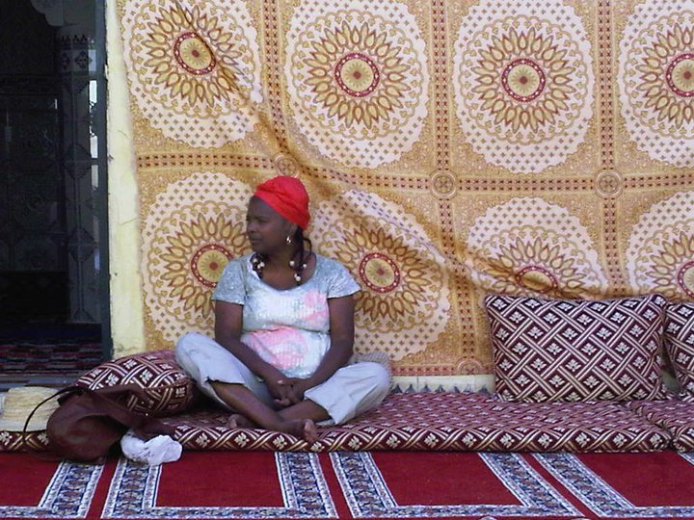
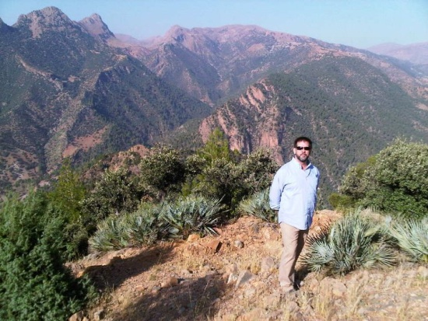
Back to morocco
Amezray & Marrakech
Zaouia of Beni Mellal, Dar Ahansal, Bahia Palace, Chez Ali
Lecture
- Beardslee (Jemaa el-Fnaa)

