Slide 1
Optimality Principles and Identification of Dynamic Models of Biosystems
CUNY-Courant Seminar in Symbolic-Numeric Computing
CUNY Graduate Center, Friday, May 11, 2018
Julio R. Banga
IIM-CSIC, Vigo, Spain
julio@iim.csic.es

Slide 2
Outline
Dynamic models of biosystems
Optimality principles
Optimal control
Inverse optimal control
Case studies
Conclusions

Slide 3
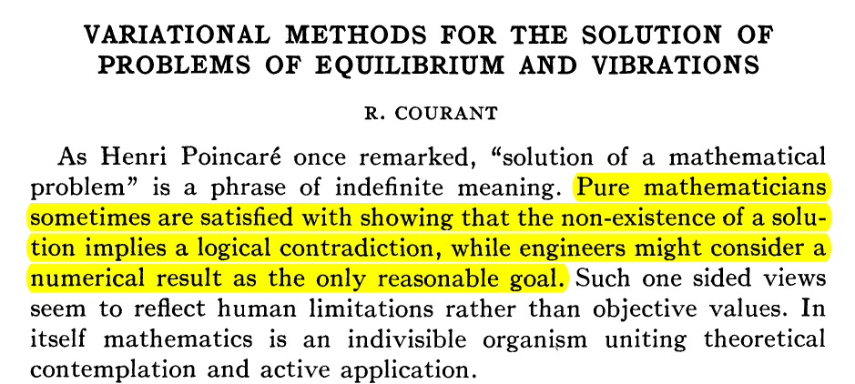
Courant, R. (1943). Variational methods for the solution of problems of equilibrium and vibrations. Bulletin of the American mathematical Society, 49(1), 1-23.

Slide 4
Dynamic modelling of biological systems

Slide 5
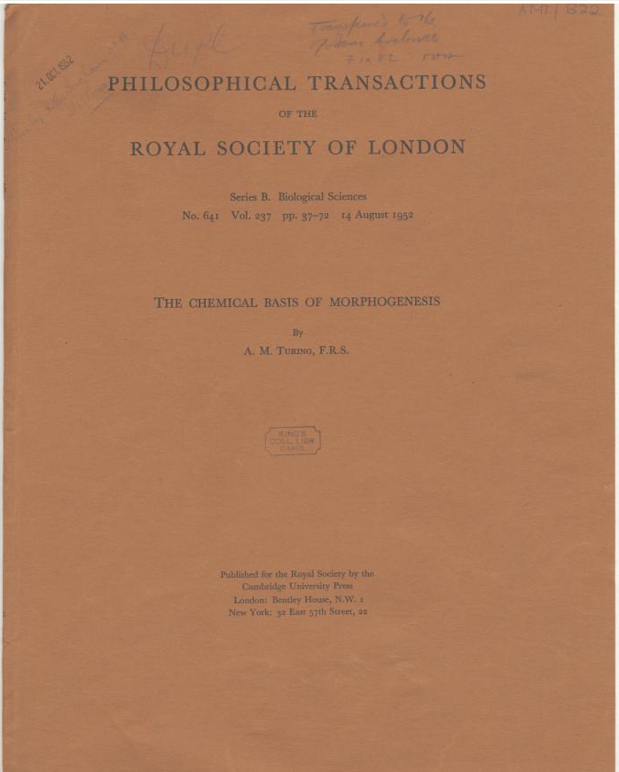
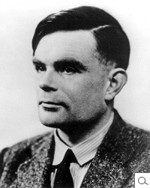
Alan Turing (1952) ‘The chemical basis of morphogenesis’ from Philosophical Transactions of the Royal Society of London, (Series B, No.641, Vol. 237).

Slide 6
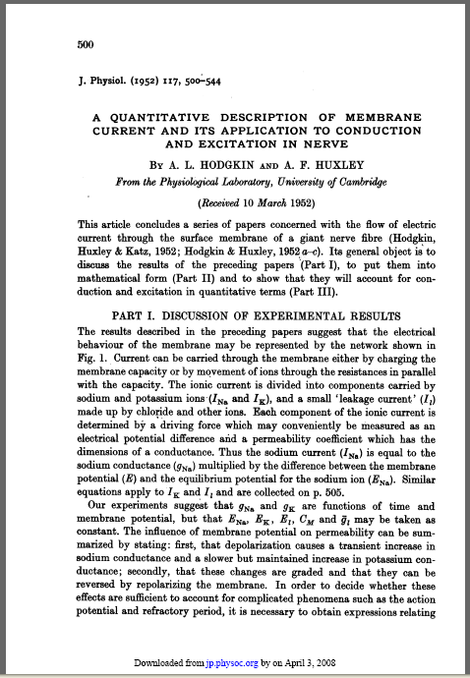
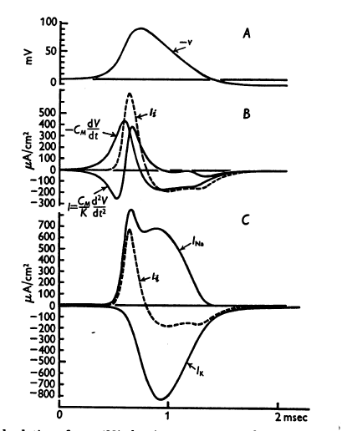
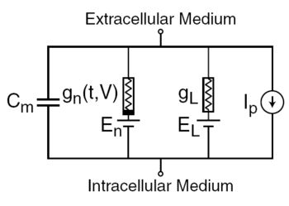
Hodgkin, A. L. and Huxley, A. F. (1952) A quantitative description of ion currents and its applications to conduction and excitation in nerve membranes. J. Physiol. (Lond.), 117:500-544.

Slide 7
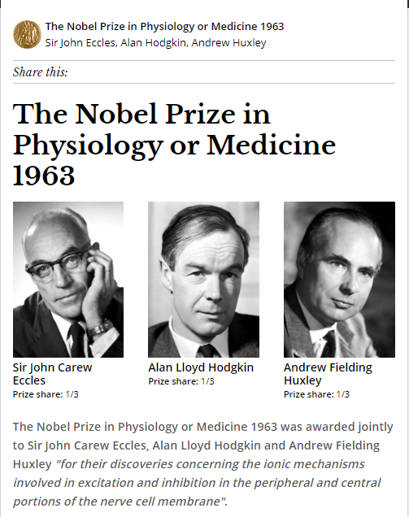

Slide 8
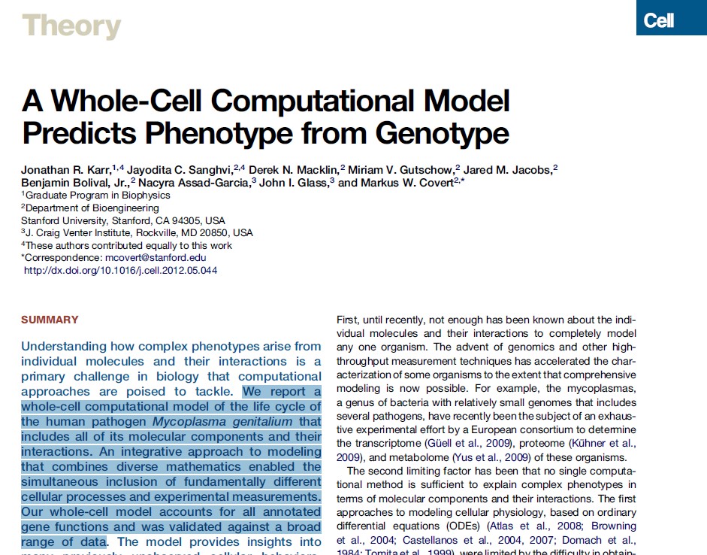
2012

Slide 9
Modelling formalisms in
Systems Biology
Boolean networks
Bayesian networks
Petri nets
process algebras
constraint-based models
differential equations
rule-based models
interacting state machines
cellular automata
agent-based models
Machado et al. (2011) Modeling formalisms in Systems Biology. AMB Express 2011, 1:45

Slide 10
Modelling formalisms in
Systems Biology
Boolean networks
Bayesian networks
Petri nets
process algebras
constraint-based models
differential equations
rule-based models
interacting state machines
cellular automata
agent-based models
Machado et al. (2011) Modeling formalisms in Systems Biology. AMB Express 2011, 1:45

Slide 11
Deterministic ODEs
Deterministic nonlinear dynamic model (state space representation)

Slide 12
Mendes, P. (2001) Modeling large scale biological systems from functional genomic data: parameter estimation. in Foundations of Systems Biology (Kitano, H., ed), MIT Press, Cambridge, MA, pp. 163-186.

Slide 13
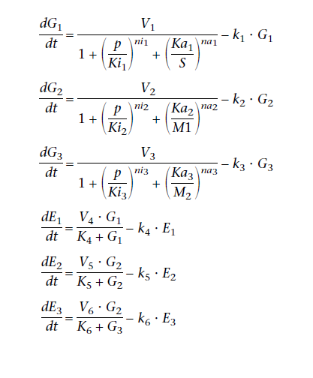
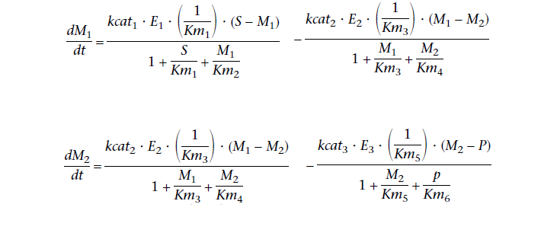
Mendes, P. (2001) Modeling large scale biological systems from functional genomic data: parameter estimation. in Foundations of Systems Biology (Kitano, H., ed), MIT Press, Cambridge, MA, pp. 163-186.

Slide 14
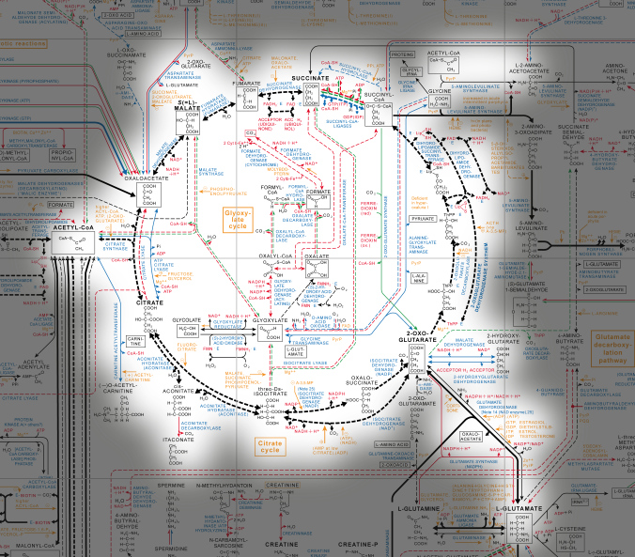

Slide 15
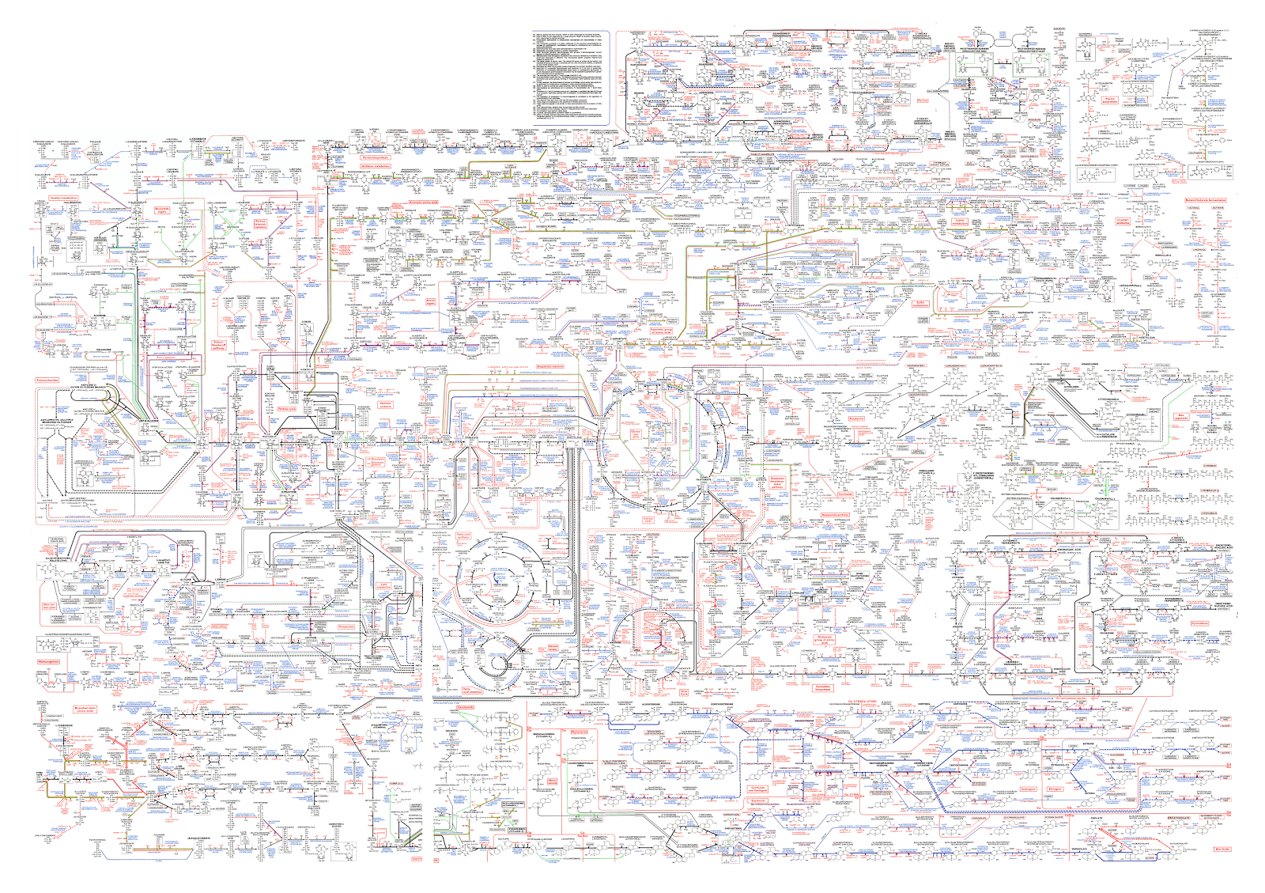
Roche Biochemical Pathways - http://biochemical-pathways.com/#/map/1

Slide 16
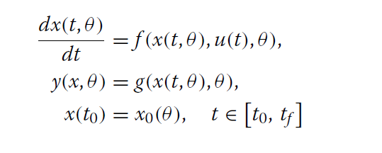
Forward problem

Initial value problem (IVP)

Slide 17
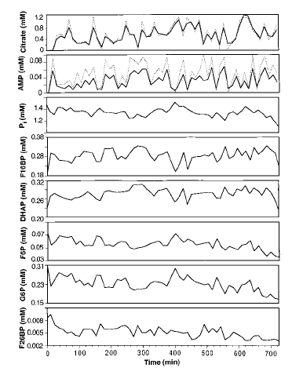
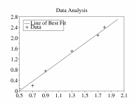
Inverse problem: Parameter estimation
Data
Experiment
Optimization
Solver
Fitted Model
Model

Slide 18
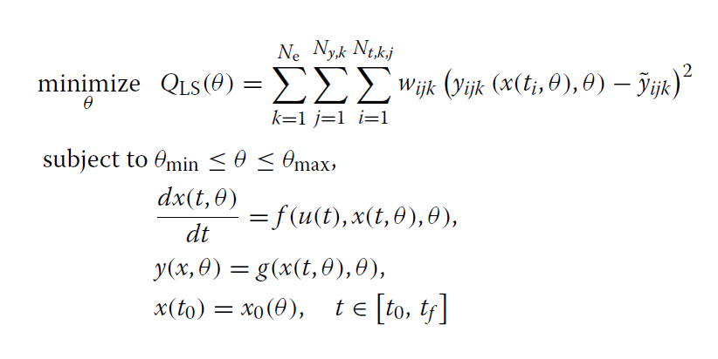
Inverse problem: Parameter estimation

Slide 19
Inverse problems
Hadamard (1902) on well-posed problems:
A solution exists
The solution is unique
Stability: the solution's behavior hardly changes when there's a slight change in the initial condition or parameters (the solution depends continuously on the data)
J. Hadamard (1902) Sur les problèmes aux dérivés partielles et leur signification physique. Princeton University Bulletin, 13:49–52.

Slide 20
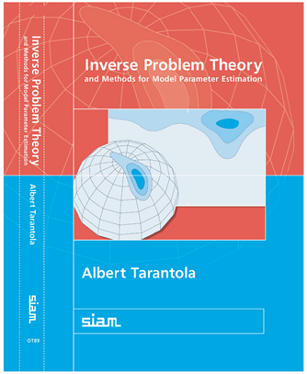

Slide 21
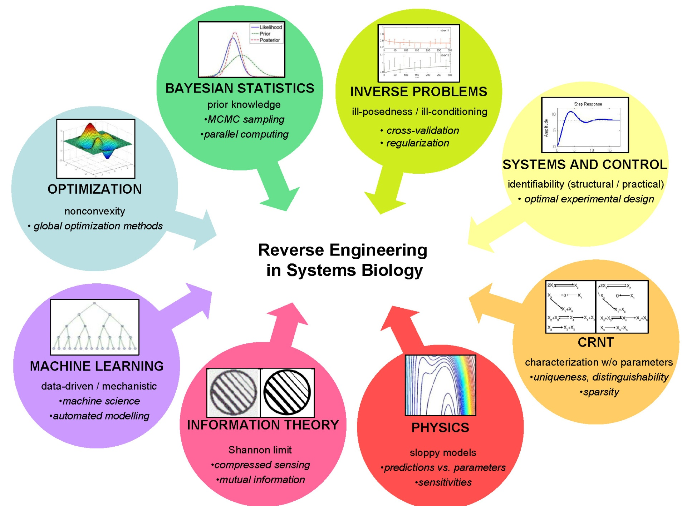
Villaverde, A.F. and J.R. Banga (2014) Reverse engineering and identification in systems biology: strategies, perspectives and challenges. J. Royal Soc. Interface 11(91):20130505.

Slide 22
Dynamic Model Building
Kinetic Model
Network Inference
Parametric Identification
Identifiability
Analysis

Slide 23
Identifiability
Structural identifiability
A model is structurally identifiable if it is theoretically possible to uniquely estimate its parameters under the ideal scenario of continuous noiseless input-output data.
Global/local structural identifiability
Practical identifiability
A model is identifiable in practice if (i) it is structurally identifiable, and (ii) we have sufficiently rich experimental data to achieve high-quality parameter estimates.

Slide 24
Lack of Identifiability
What can be done?
Lack of structural identifiability
Reformulate model (e.g. reduce number of parameters)
Design more informative input-output mappings
Exploit prior knowledge (constraints, regularization, etc.)
Lack of practical identifiability
Design and execute more informatve experiments
Try to reduce noise in measurements
Exploit prior knowledge (constraints, regularization, etc.)

Slide 25
Optimality principles in biology… Why?

Slide 26
Optimality principles

Slide 27
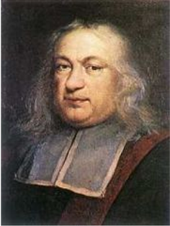
Optimality in physics
“Light travels between two given points along the path of shortest time“
(principle of least time or Fermat's principle; 1662)

Slide 28
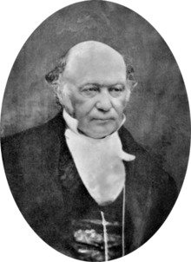
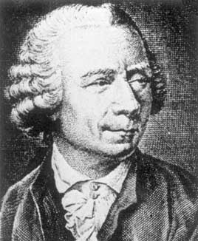
Optimality in physics
“A dynamic system always follows a path such that its action integral is stationary (that is, maximum or minimum)”
(Hamilton's principle; 1834 /
& least action principle; Euler, 1744)

Slide 30
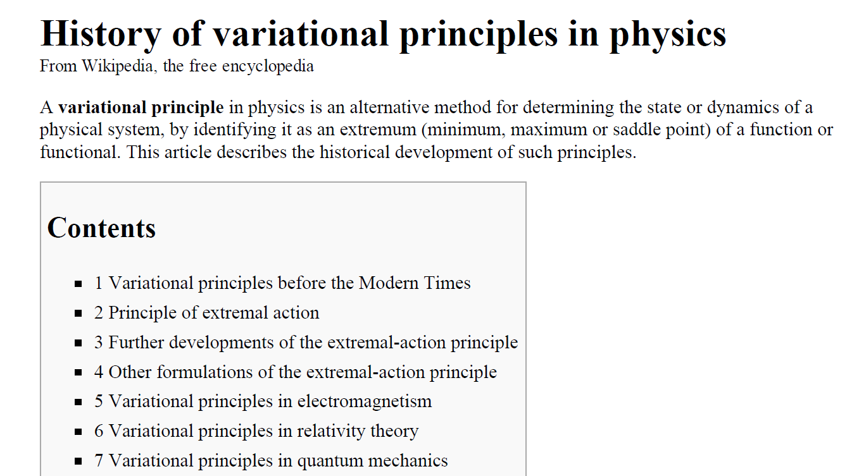
Optimality in physics

Slide 31
Optimality principles
in biology

Slide 32
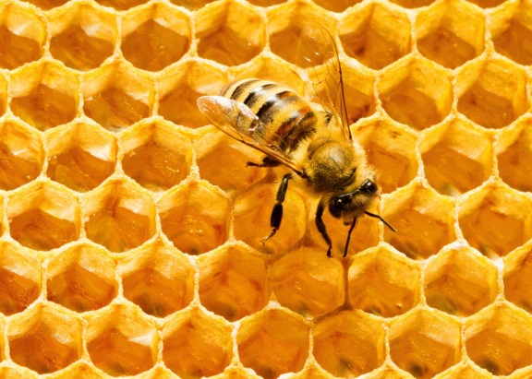
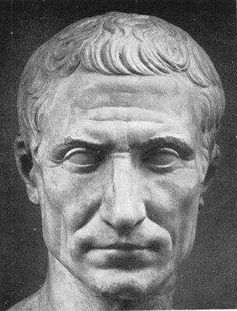
Optimal designs in biology
Honey bees build their hexagonal cells in order to achieve the best economy of material
Varro, M. T. Rerum Rusticarum Libri III (37 B.C.).

Slide 33
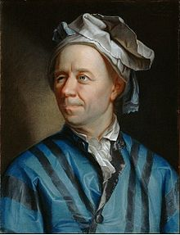
Since the building of the universe is perfect and is created by the wisdom Creator, nothing arises in the universe in which one cannot see the sense of some maximum or minimum.
Leonhard Euler

Slide 34
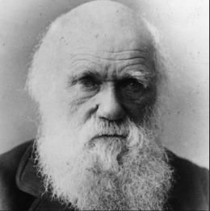
Optimal designs in biology
Bees that stored the most honey with the least wax would have a survival advantage
Darwin, C. On the origin of species by means of natural selection, or the preservation of favoured races in the struggle for life (John Murray, 1859).

Slide 35
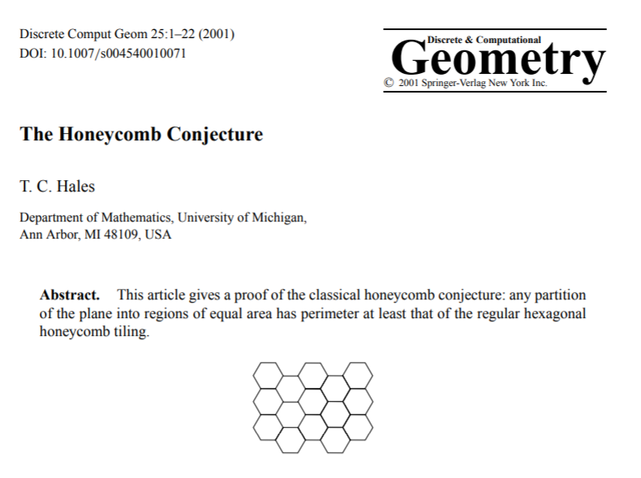
Optimal designs in biology
Hales, T. C. (2001). The honeycomb conjecture. Discrete & Computational Geometry, 25(1), 1-22.

Slide 36
Basic concept:
optimality in a biology
as a consequence
of natural selection (evolution)

Slide 37
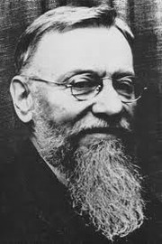
Optimal design in biology
Principle of Optimal Design
“The [biological] structure necessary for performing a given function be optimal relatively to energy and material needs.”
“Given that the same biological functions can be performed by different structures, the particular structure found in nature is the simplest one compatible with the performance of a function or set of functions”
Rashevsky, N. (1938) Mathematical Biophysics: Physico Mathematical Foundations of Biology. Univ. of Chicago Press, 1938/1948 (2nd ed.).
Nicolas Rashevsky

Slide 38
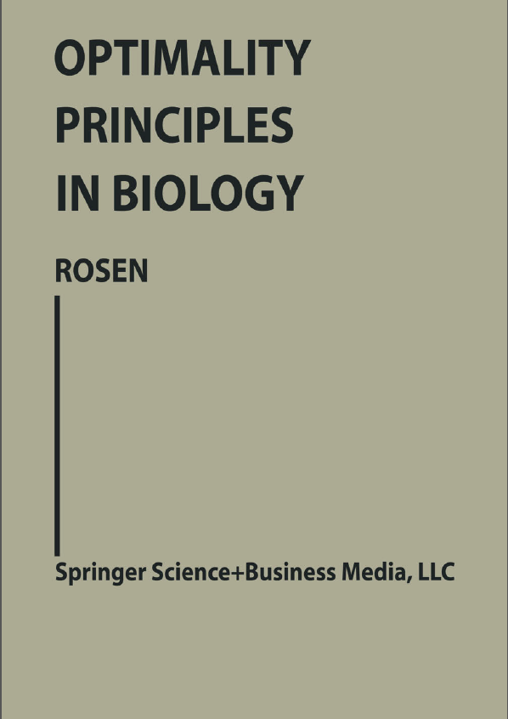
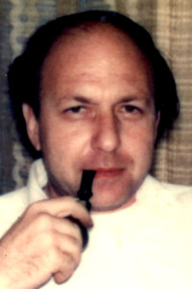
Robert Rosen
Rosen, R. (1967) Optimality principles in biology. Springer.

Slide 39
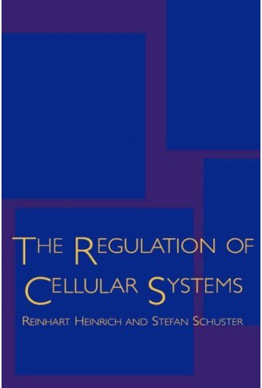
1996

Slide 40
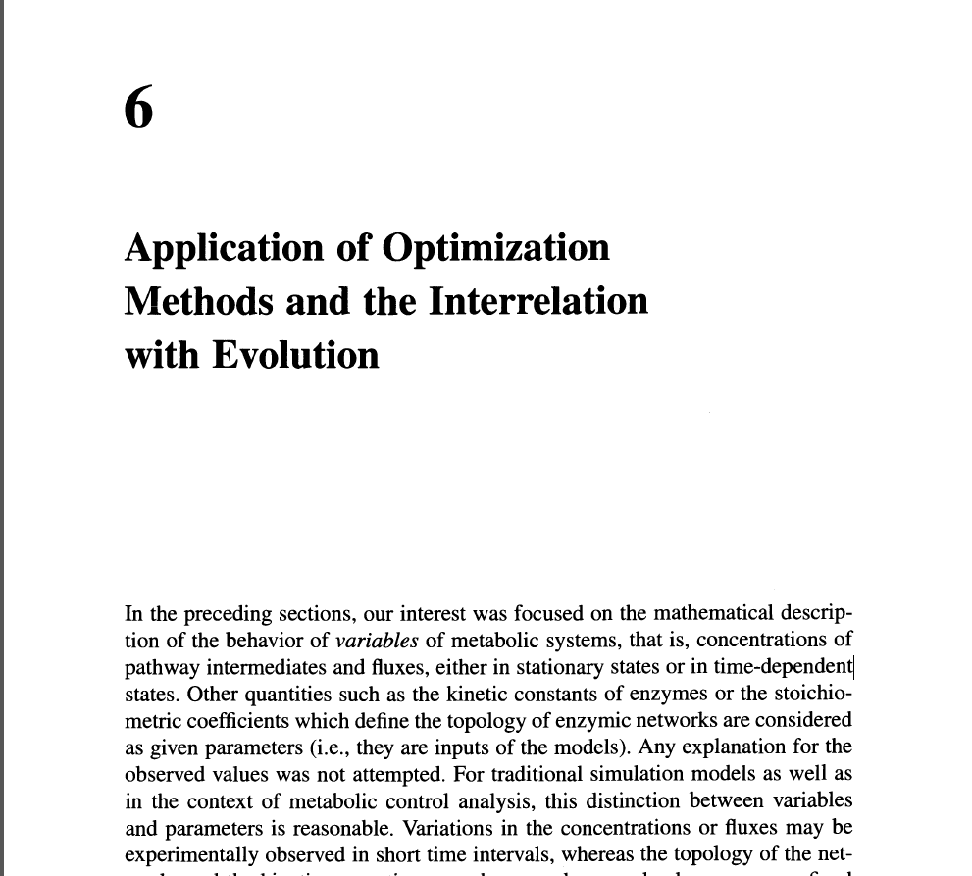
Heinrich & Schuster (1996)

Slide 41
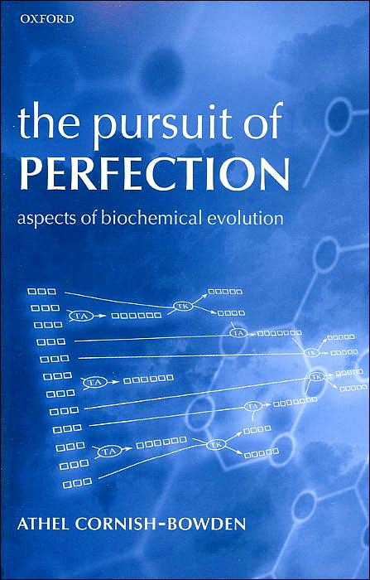
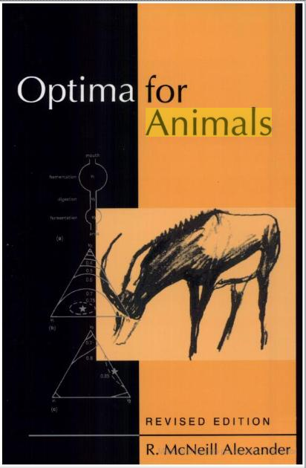
Optimality-based explanations, from biochemical reactions to
the structures, movements and behaviors of animals

Slide 42
“…in a context of increasing calls for biology to be predictive, optimization is the only approach biology has for making predictions from first principles.”
Sutherland, W.J. (2005) The best solution. Nature 435:569

Slide 43
Optimal control

Slide 44
Open loop optimal control = Dynamic optimization

Slide 45
Optimal control Given a dynamic model of a system, find how to manipulate/change it (dynamically) so that you get optimal performance

Slide 46
Optimal control – a brief history - Calculus of variations (Bernoulli, 1696; Euler, 1740; Lagrange, 1755)

Slide 47
Brachistochrone Problem
In 1696 Johann Bernoulli published a challenge problem in the journal Acta Eruditorum.
Find the shape of the curve down which a bead sliding from rest and accelerated by gravity will slip (without friction) from one point to another in the least time.

Slide 48
Brachistochrone Problem
Find the shape of the curve down which a bead sliding from rest and accelerated by gravity will slip (without friction) from one point to another in the least time.

Slide 49
Brachistochrone Problem
Find the shape of the curve down which a bead sliding from rest and accelerated by gravity will slip (without friction) from one point to another in the least time.

Slide 50
Optimal control – a brief history - Calculus of variations (Euler, 1740; Lagrange, 1755; Bernoulli, 1696) - Dynamic programming (Bellman, 1953) - Pontryagin’s maximum principle (1956) - Modern direct methods (1970s-…)

Slide 51
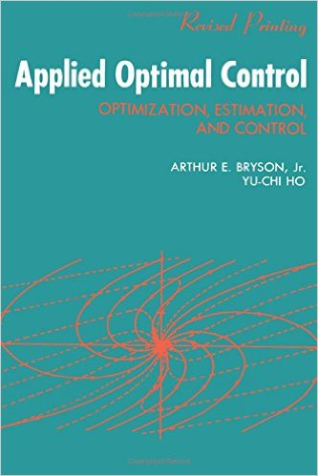
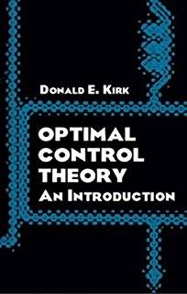
Modern optimal control

Slide 52
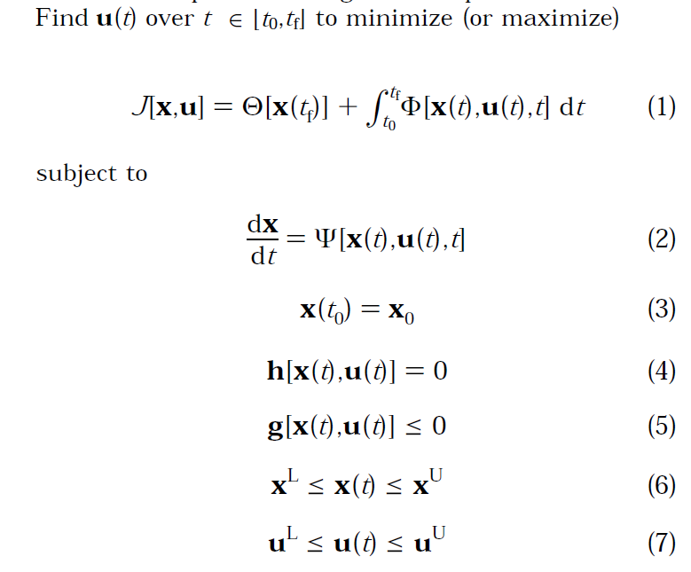

Slide 53
Modern numerical optimal control
Continuous Optimal Control
Problem
Control parameterization
State & Control
parameterization
Single
shooting
Multiple
shooting

Slide 54
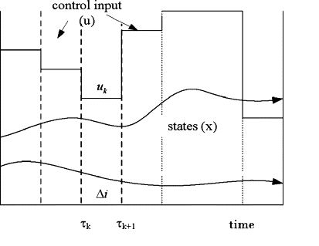
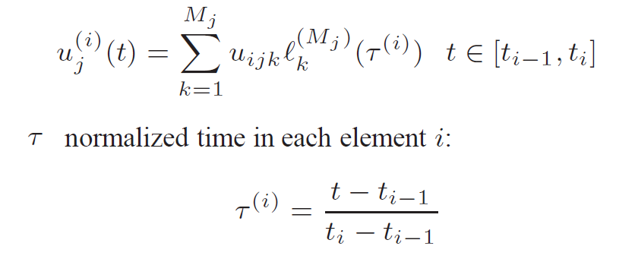
Control Vector Parameterization
Discretize controls using basis functions
Solve the resulting NLP-ODE problem
Single shooting approach

Slide 55
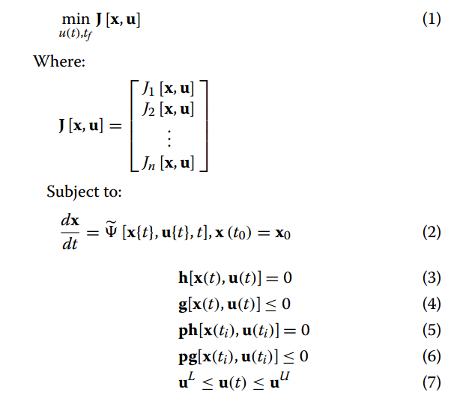
Multi-objective Dynamic Optimization

Slide 56
Why Multi-objective Optimal Control?

Slide 57
Optimal design in biology
Principle of Optimal Design
“The [biological] structure necessary for performing a given function be optimal relatively to energy and material needs.”
Rashevsky, N. (1938) Mathematical Biophysics: Physico Mathematical Foundations of Biology. Univ. of Chicago Press, 1938/1948 (2nd ed.).
Nicolas Rashevsky

Slide 58
1996

Slide 59
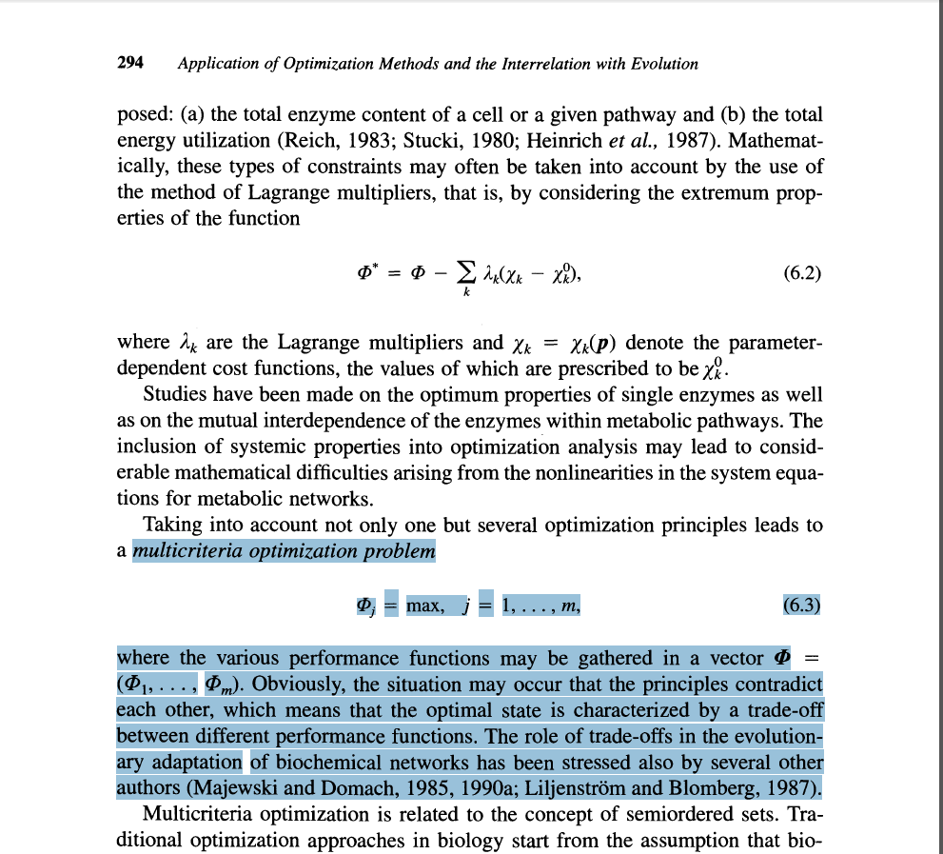
Heinrich & Schuster (1996)

Slide 60
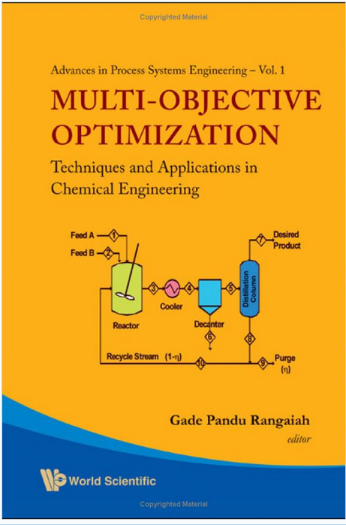
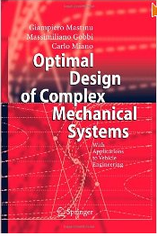
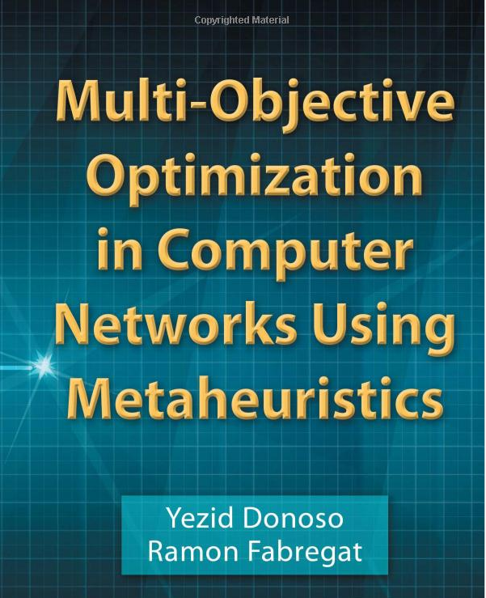
Multi-objective optimization in engineering

Slide 61
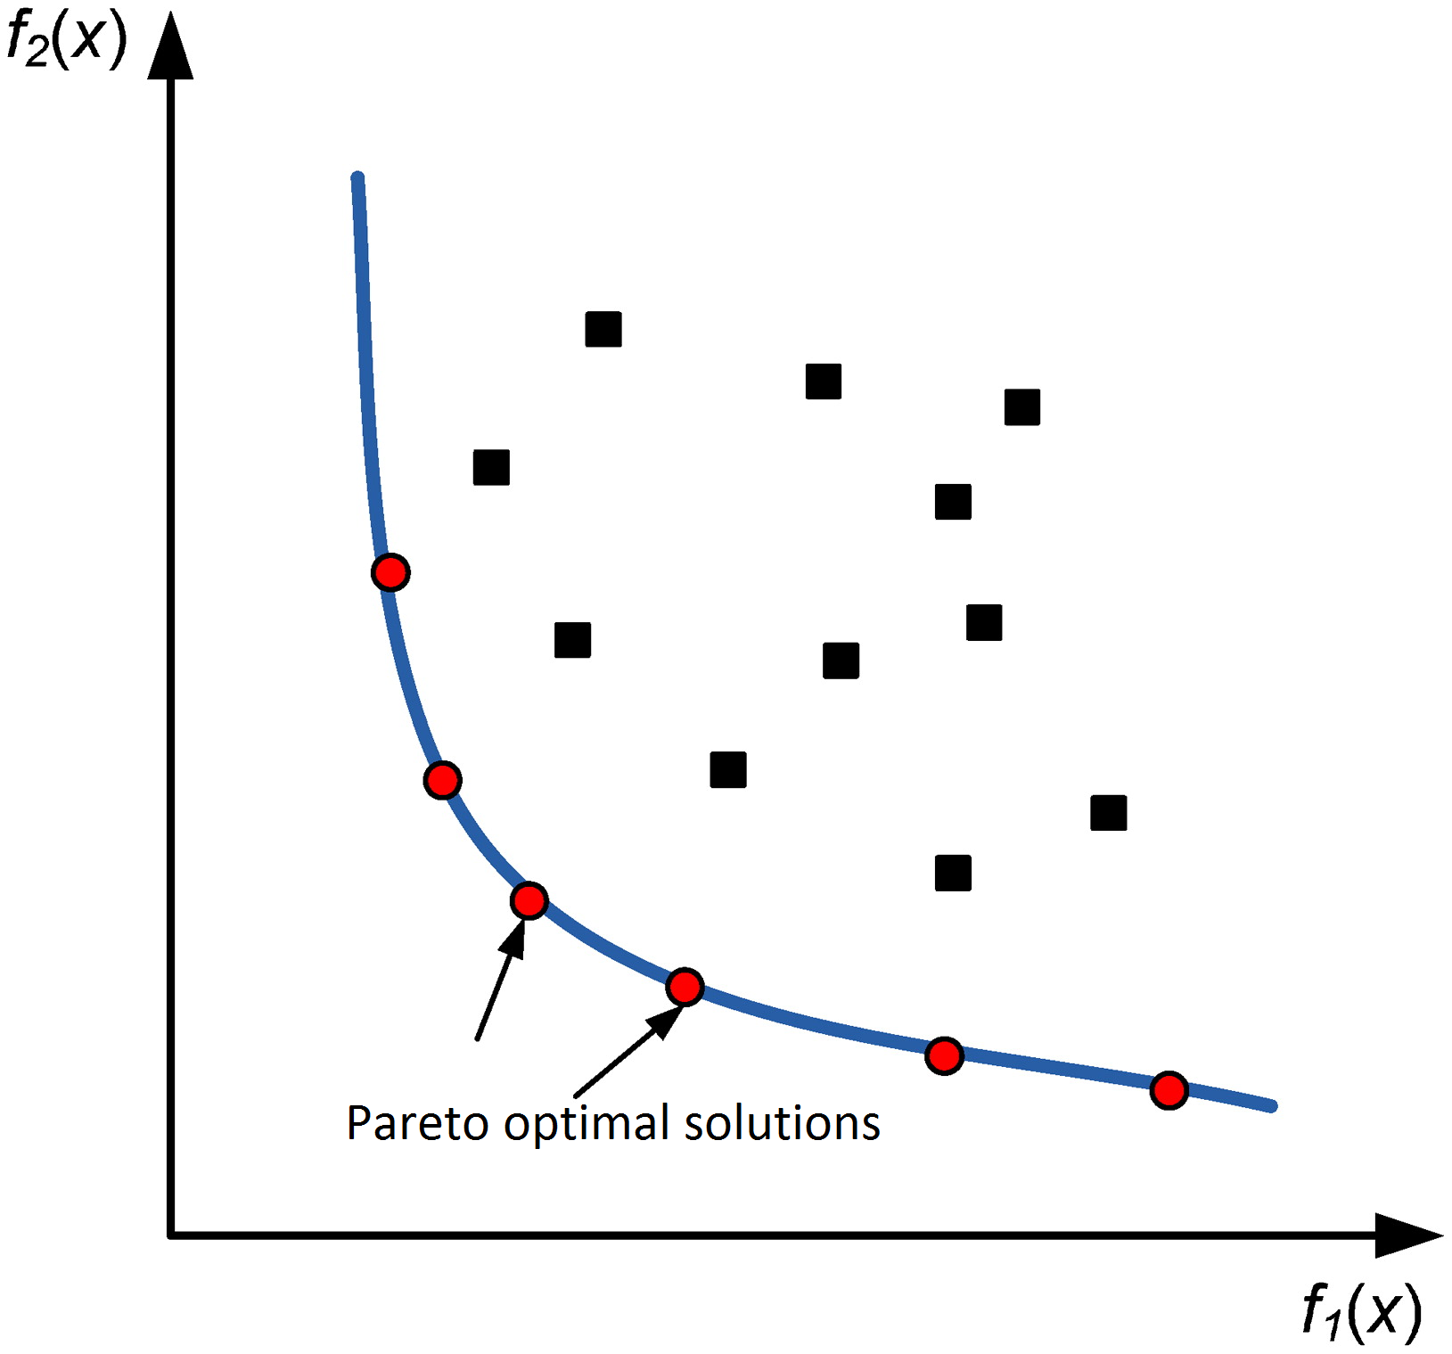
Pareto optimality

Slide 62
Prediction of Dynamics in Metabolic Pathways

Slide 63
Mendes, P. (2001) Modeling large scale biological systems from functional genomic data: parameter estimation. in Foundations of Systems Biology (Kitano, H., ed), MIT Press, Cambridge, MA, pp. 163-186.

Slide 64
In general, detailed regulation is unknown…
Mendes, P. (2001) Modeling large scale biological systems from functional genomic data: parameter estimation. in Foundations of Systems Biology (Kitano, H., ed), MIT Press, Cambridge, MA, pp. 163-186.

Slide 65
In general, detailed regulation is unknown…
Can we predict dynamics without knowing the regulatory mechanisms?
Mendes, P. (2001) Modeling large scale biological systems from functional genomic data: parameter estimation. in Foundations of Systems Biology (Kitano, H., ed), MIT Press, Cambridge, MA, pp. 163-186.

Slide 66
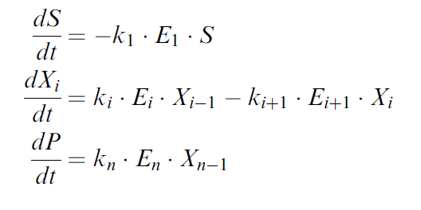
Prediction of Activation in Metabolic Pathways
Genetic regulation of metabolic networks seems to follow an optimality principle (e.g. minimization of the transition time)
Klipp E, Heinrich R, Holzhütter HG (2002) Prediction of temporal gene expression. Metabolic optimization by re-distribution of enzyme activities. Eur J Biochem 2002, 269:5406-5413

Slide 67
Prediction of Activation in Metabolic Pathways
Genetic regulation of metabolic networks seems to follow an optimality principle (e.g. minimization of the transition time)
Thus, given a kinetic model of a metabolic pathway, we can solve a dynamic optimization problem to predict behavior (enzyme concentrations, gene expression)
Klipp E, Heinrich R, Holzhütter HG (2002) Prediction of temporal gene expression. Metabolic optimization by re-distribution of enzyme activities. Eur J Biochem 2002, 269:5406-5413

Slide 68
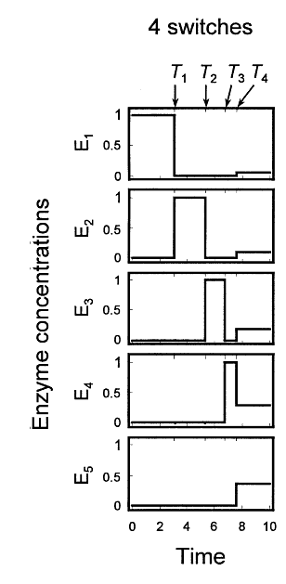
Prediction of Activation in Metabolic Pathways
Thus, given a kinetic model of a metabolic pathway, we can solve a dynamic optimization problem to predict behavior (enzyme concentrations, gene expression)
Klipp E, Heinrich R, Holzhütter HG (2002) Prediction of temporal gene expression. Metabolic optimization by re-distribution of enzyme activities. Eur J Biochem 2002, 269:5406-5413
Zaslaver A, Mayo AE, Rosenberg R, Bashkin P, Sberro H, Tsalyuk M, Surette M, Alon U (2004) Just-in-time transcription program in metabolic pathways. Nat Genet 2004, 36:486-491

Slide 69
Prediction of Activation in Metabolic Pathways
Can we extend this to more realistic networks?
- arbitrary network topologies and kinetics?
- scaling up well with network size?
- multi-objective formulations?

Slide 70
Multi-objective Optimal Control

Slide 71
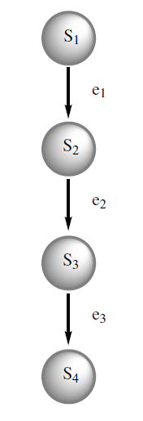
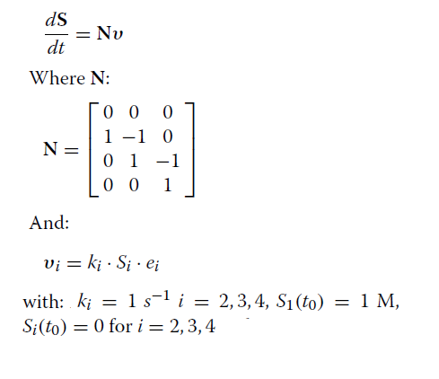
Simple case: linear pathway with mass action kinetics
de Hijas-Liste, G.M., E. Klipp, E. Balsa-Canto, J.R. Banga (2014) Global dynamic optimization approach to predict activation in metabolic pathways. BMC Systems Biology 8:1.

Slide 72
Single-objective optimal control
Find optimal controls e_{i} to:
Minimize transition time
Subject to
End-point constraint with 90% conversion
Path constraint on total enzyme conc.
Bounds on controls, 0 <= e_{i} <= 1

Slide 73
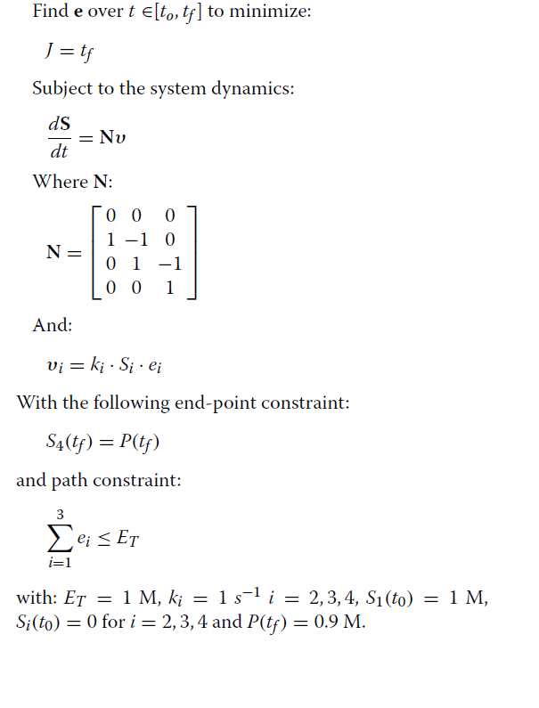
Single-objective optimal control

Slide 74
Single-objective optimal control
de Hijas-Liste, G.M., E. Klipp, E. Balsa-Canto, J.R. Banga (2014) Global dynamic optimization approach to predict activation in metabolic pathways. BMC Systems Biology 8:1.

Slide 75
Multi-objective optimal control
Find optimal controls e_{i}(t) to:
Minimize time and concentrations of S₂ and S₃
Subject to
End-point constraint with 90% conversion
Path constraint on total enzyme conc.
Bounds 0 <= e_{i}(t) <= 1

Slide 76
Multi-objective optimal control

Slide 77
Multi-objective optimal control
de Hijas-Liste, G.M., E. Klipp, E. Balsa-Canto, J.R. Banga (2014) Global dynamic optimization approach to predict activation in metabolic pathways. BMC Systems Biology 8:1.

Slide 78
OPTIMALITY PRINCIPLE
Dynamic Model
Constraints
OPTIMAL CONTROL
Explanation / prediction of DYNAMICS

Slide 79
OPTIMALITY PRINCIPLE
Dynamic Model
Constraints
OPTIMAL CONTROL
Explanation / prediction of DYNAMICS
BUT, how can we know the
Optimality Principle?

Slide 80
Finding the Optimality Principle
Experiments
Study data
Hypothesis
Test
Usual approach: study data, hypothesize, test
Time-consuming
Difficult to apply with multicriteria optimality

Slide 81
Inverse Optimal Control
A systematic way of inference of optimality principles

Slide 82
Inverse Optimal Control
A systematic way of inference of optimality principles
Given a model and observed data, estimate:
the model parameters
the unmeasured time-dependent inputs
underlying optimality criteria

Slide 83
Dynamic data (time-series)
Dynamic Model
Constraints
INVERSE OPTIMAL CONTROL
OPTIMALITY PRINCIPLE

Slide 84
Inverse Optimal Control
Related approaches in:
Control theory
Machine learning
Biomimetics / robotics
Bi-level optimal control formulation
Examples

Slide 85
Inverse Optimality & Stability
Kalman, R. E. (1964). When is a linear control system optimal?. Journal of Basic Engineering, 86(1), 51-60.

Slide 86
Inverse Reinforcement Learning
Ng, A. Y., & Russell, S. J. (2000, June). Algorithms for inverse reinforcement learning. In Icml (pp. 663-670).

Slide 87
Pauwels, E., Henrion, D., & Lasserre, J. B. (2018). Inverse optimal control with polynomial optimization. arxiv.org/abs/1403.5180

Slide 88
Inverse Optimal Control for BioSystems
Requirements:
(Large) Nonlinear ODE models
Partially observed
Highly constrained
Multicriteria Optimality

Slide 89
Bi-level Nonlinear Optimal Control
Given a model, data, and a finite set of costs,
Find the best trade-off cost function that solves:
the inverse identification problem
Subject to:
the optimal control problem

Slide 92
Input Reconstruction Problem
(Optimal tracking)

Slide 93
Input reconstruction problem
Global (structural) identifiability – pre-requisite for well-posedness
Identifiability/recoverability – open question for the general case
Can u(t) be uniquely recovered from the available input-output data for the ideal case (noiseless data, error-free model)?
Few works about global structural identifiability for particular cases:
e.g. known parametrized input

Slide 94
Example: Identifiability of time-varying parameters using differential algebra
Miao, H., Xia, X., Perelson, A. S., & Wu, H. (2011). On identifiability of nonlinear ODE models and applications in viral dynamics. SIAM review, 53(1), 3-39.

Slide 95
Example: Identifiability of time-varying parameters using differential algebra
Miao, H., Xia, X., Perelson, A. S., & Wu, H. (2011). On identifiability of nonlinear ODE models and applications in viral dynamics. SIAM review, 53(1), 3-39.

Slide 96
Example: Identifiability of time-varying parameters using differential algebra
Miao, H., Xia, X., Perelson, A. S., & Wu, H. (2011). On identifiability of nonlinear ODE models and applications in viral dynamics. SIAM review, 53(1), 3-39.

Slide 97
Numerical solution strategy
Tsiantis, N., Balsa-Canto, E., Banga, J. R. (2018). Optimality and identification of dynamic models in systems biology: an inverse optimal control framework. Bioinformatics, bty139

Slide 98
Regularization

Slide 99
Example 1.- Linear pathway

Slide 102
Kinetic parameters
Optimal controls e_{i}
Optimality principle
Kinetic model
(ODEs)
Possible cost functions

Slide 109
Example 2.- Central carbon metabolism of S. cerevisiae
PYR
GLU
TPH
ETH
Tsiantis, N., Balsa-Canto, E., Banga, J. R. (2018). Optimality and identification of dynamic models in systems biology: an inverse optimal control framework. Bioinformatics, bty139

Slide 110
PYR
GLU
TPH
ETH

Slide 111
Central carbon metabolism of S. cerevisiae
Experiment: measured dynamics of central carbon metabolism of yeast during diauxic shift experiment
Nutrient depletion scenario: limited initial amounts of glucose and ethanol
Possible cost functions: survival time and enzyme synthesis cost
Apply Inverse Optimal Control to:
- find controls, parameters and optimality criterion
- compare with measured gene expression profiles

Slide 116
Conclusions

Slide 117
 Optimality principles in biology - consequence of evolution - Pareto optimality (multicriteria)  Optimal control can be used to explain/predict dynamics if the optimality principle is known  Optimality principle from observations? -> inverse optimal control  Future work: - identifiability in general IOCPs - dynamic games
Conclusions

Slide 118
Acknowledgements
Nikolaos Tsiantis, Eva Balsa Canto
Tsiantis, N., Balsa-Canto, E., Banga, J. R. (2018). Optimality and identification of dynamic models in systems biology: an inverse optimal control framework. Bioinformatics, bty139

Slide 119
Acknowledgements
IIM-CSIC: Alex F. Villaverde, Irene Otero, David Henriques, Attila Gabor, David R. Penas, Gundian de Hijas-Liste
Edda Klipp (Berlin)
Funding

Slide 120
Thank you!
julio@iim.csic.es

